Slide 1
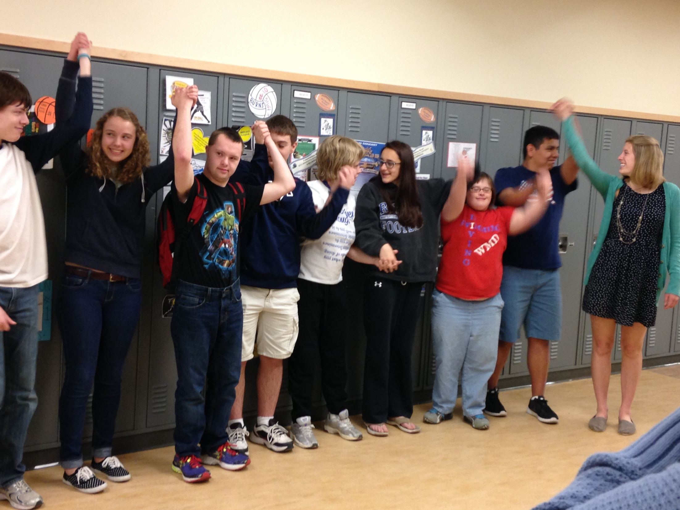
Advocacy and Self-Advocacy What does it have to do with bullying prevention?
Notes:
Slide title: Cover Slide
Objective: Slide to show onscreen pre-presentation
PACER’s National Bullying Prevention Center
Is a program of PACER Center 8161 Normandale Blvd. | Bloomington, MN 55437
952.838.9000
bullying411@PACER.org
PACER.org/Bullying
Founded in 2006, PACER's National Bullying Prevention Center actively leads social change to prevent childhood bullying, so that all youth are safe and supported in their schools, communities and online. PACER provides innovative resources for students, parents, educators, and others, and recognizes bullying as a serious community issue that impacts education, physical and emotional health, and the safety and well-being of students..
PACER.org/Bullying: This is the portal page for parents and educators to access bullying resources, which include educational toolkits, awareness toolkits, contest ideas, promotional products and more.
PACERTeensAgainstBullying: Created by and for teens, this website is a place for middle and high school students to find ways to address bullying, to take action, to be heard, and to own an important social cause.
PACERKidsAgainstBullying: A creative, innovative and educational website designed for elementary school students to learn about bullying prevention, engage in activities and be inspired to take action

Slide 2
What is Advocacy?
Advocacy
Looking out for other students who are being bullied, are vulnerable to being hurt or harmed, or are isolated from other students.
Advocates help by making sure that these students are included and protected from harm.
Notes:
Slide title: What is advocacy?
Objective: Provide an overview of advocacy
Talking Points:
First, let’s consider what advocacy is before discussing how it relates to bullying prevention.
What is advocacy? Advocacy means looking out for other students who are being bullied, are vulnerable to being hurt or harmed, or are isolated from other students. Advocates help by making sure that these students are included and protected from harm.
Students who are advocates say:
“I learned that even though I am only one person I can change society.”
“Being an advocate makes me more aware when someone is not being included, and it is a lot easier to include them and still have them feel comfortable. I have learned that there is so much more to me than just who I was before.”

Slide 3
Connection Between Advocacy and Bullying Prevention
Advocacy empowers students to protect those targeted by bullying. It works for two reasons:
Students are more likely than adults to see what is happening with their peers, and peer influence is powerful.
A student telling someone to stop bullying often has much more impact than an adult giving that same advice.
Notes:
Slide title: Connection between advocacy and
bullying prevention
Objective: Identify how advocacy relates to
bullying prevention
Talking Points:
Advocacy—speaking out on the behalf of others — is a unique approach that empowers students to protect those targeted by bullying.
It works for two reasons:
Students are more likely than adults to see what is happening with their peers, and peer influence is powerful. In fact, peers are often aware of bullying situations before adults in the school. This is because bullying often happens in hallways, at lunch, during recess, and on the bus. It is therefore important that students feel empowered to advocate safely for their peers.
A student telling someone to stop bullying has much more impact than an adult giving that same advice. Students who experience bullying are more likely to find peer actions as helpful than educator or self-actions. Peers have a unique power to prevent bullying through advocacy. More than half of bullying situations (57 percent) stop when a peer intervenes and advocates on behalf of the student being bullied.

Slide 4
How to Advocate for Peers Experiencing Bullying
Be a friend! Watch out for those students who might need your help:
Sit by them at lunch
Talk with them in the hallway
Include them in group activities
Invite them to spend time with you
Listen to their concerns
Provide advice and support
If you know that someone is being teased, hurt, or harmed in any manner, you can:
Get them away from the situation
Ask the person bullying to leave them alone (only if it feels safe to say something)
Let them know that everyone deserves to be safe
Help them talk with adult
Report it to an adult on their behalf
Notes:
Slide title: How to advocate for bullied peers
Objective: Share ideas for how students can
advocate for a peer they see being bullied
Talking Points:
Most students don’t like to see bullying, but they may not know what to do when it happens. As an advocate, learn how to use your strengths in order to effectively advocate for those who are targeted by bullying. Here are some ideas on how to advocate for peers you see being bullied:
Be a friend! Watch out for those students who might need your help and have their backs. To be a friend, you can:
Sit by them at lunch
Talk with them in the hallway
Include them in group activities
Invite them to spend time with you
Listen to their concerns
Provide advice and support
If you know that someone is being teased, hurt, or harmed in any manner, you can:
Get them away from the situation.
Ask the person bullying to leave them alone (only if it feels safe to say something)
Let them know that everyone deserves to be safe.
Help them talk with adult.
Report it to an adult.
There are many ways to advocate for bullied peers. Most importantly, do something that will help make the bullying stop, make the person being bullied feel better, and that is safe for you to do.

Slide 5
Student Advocates Quotes
Students who have been peer advocates said, “When I saw bullying happen, I…”
took action, instead of just doing nothing
told them to stop being so mean
told someone saying “that’s so retarded” hurts people with disabilities and is not acceptable
stepped in and told them to stop
privately told the person bullying that what they did wasn’t cool
told our mentor, who helped me know what to do the next time
Notes:
Slide title: Student advocates quotes
Objective: To share the actions of students who advocate
Talking Points:
You have the power to help out your bullied peers. Many students who are advocates say they benefit from learning skills such as empathy, inclusion, leadership, and acceptance. Students who have been peer advocates said, “when I saw bullying happen, I…”
took action, instead of just doing nothing
told them to stop being so mean
told someone saying “that’s so retarded” hurts people with disabilities and is not acceptable
stepped in and told them to stop
privately told the person bullying that what they did wasn’t cool
told our mentor, who helped me know what to do the next time
stood up for myself when it was me who was bullied

Slide 6
What is Self-Advocacy?
What does it mean to advocate for yourself?
--------------------------------------------------------------
Self-advocacy means communicating on your own behalf, letting others know what you need, and taking action in a direct and respectful manner.
For example, if you are at a store and a clerk ignores you, you are able to ask in a polite way to be served.
Notes:
Slide title: What is self-advocacy?
Objective: Provide an overview of self-advocacy
Talking Points:
We now know how you can advocate for others, but let’s learn how you can advocate for yourself.
What does it mean to advocate for yourself?
Self-advocacy means communicating on your own behalf, letting others know what you need, and taking action in a direct and respectful manner.
Being your own advocate means that you ask for what you need while respecting the needs of others. For example, if you are at a store and a clerk ignores you, you are able to ask in a polite way to be served.

Slide 7
Connection Between Self-Advocacy and Bullying Prevention
Self-advocacy empowers students to protect themselves from bullying.
Why is this skill important? Self-advocacy helps you:
Obtain what is helpful for you
Be involved in the decision-making process
Learn to say no and be okay with it
Respectfully express disagreement or different opinion
Help prevent any bullying you’re experiencing
Notes:
Slide title: Connection between self-advocacy and
bullying prevention
Objective: Identify how self-advocacy relates to
bullying prevention
Talking Points:
Self-advocacy—asking for what you need while respecting the needs of others—empowers students to protect themselves from bullying.
Why is this skill important? Self-advocacy helps you:
Obtain what is helpful for you
Be involved in the decision-making process
Learn to say no and be okay with it
Respectfully express disagreement or different opinion
Help prevent any bullying you’re experiencing

Slide 8
Steps to take:
Know that students have the right to be safe
Express what you want
Involve an adult
Reactions to avoid:
Ignore what’s happening
Fight back
Do something back to the person bullying you
Notes:
Slide title: How to become a self-advocate
Objective: Identify ideas on how students can advocate
for themselves if they are being bullied
Talking Points:
Steps to take
1) Know that students have the right to be safe
Every student has the right to be safe at school. Each state has different laws and policies on bullying, along with requirements on how schools should respond, including having a school policy. Visit StopBullying.gov to check your state’s legislation on bullying. Students might have additional protections under federal law if you are being bullied because of your race, color, national origin, sex, religion, or disability. Your school probably has bullying prevention policies. These are often printed in the school handbook or posted on the school website.
2) Express what you want
Your opinion matters! When students are involved in the solution, sharing their own ideas, that means that there is a better chance of the response strategy being realistic, fit the need, and being effective.
3) Involve an adult
If you are being bullied, you can take back control, but you don’t have to do it on your own. Begin taking back control by talking to your parent or an adult you can trust. It can also be someone at school, such as a teacher, administrator, or designated bullying liaison. When talking with an adult, remember these steps: 1) tell them about the bullying and how it makes you feel, 2) let them know that you want the bullying to stop, 3) ask what can be done so you feel safe, and 4) identify strategies to manage the bullying that you can take together.
Reactions to avoid:
Ignore what’s happening
Lots of kids try and pretend that they are okay, that the bullying is not affecting them. Or they try to avoid or ignore the person bullying you. But it can be difficult to ignore someone who is sitting behind you on the bus or next to you in class. You have the right to be safe. It’s best to try to figure out ways to fix the problem, rather than avoid it.
2) Fight back
If you ever feel like fighting back, DON’T! Trying to get even with someone who bullies is never a good idea. If you fight back, the bullying will likely become much worse. And the adults may see you as part of the problem.
3) Do something back to the person bullying you
You may want to respond with your own negative behavior, such as calling someone a name or saying something mean about them, but know that this can create more harm and escalate the situation.

Slide 9
Discussion Question
If you were the one being bullied:
What would you want your peers to do to help out?
What are ways to advocate for yourself?
Notes:
Slide title: Discussion question
Objective: Identify ways students can advocate for
themselves
Talking Points: If you were being bullied, what would you want your peers to do to help you out? What are ways to advocate for yourself?

