Slide 1
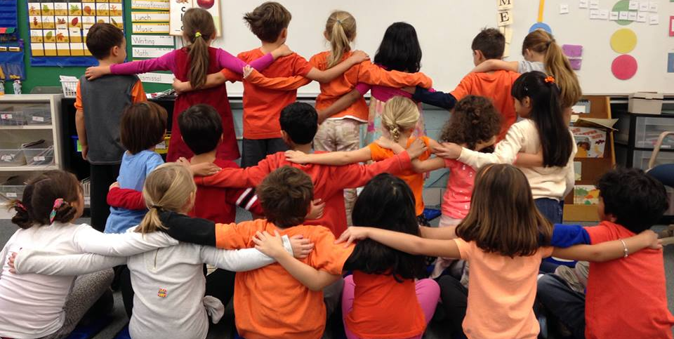
All About Inclusion
Notes:
Slide title: Cover Slide
Objective: Slide to show onscreen pre-presentation
PACER’s National Bullying Prevention Center
Is a program of PACER Center
8161 Normandale Blvd. | Bloomington, MN 55437
952.838.9000
bullying411@PACER.org
PACER.org/Bullying
Founded in 2006, PACER's National Bullying Prevention Center actively leads social change to prevent childhood bullying, so that all youth are safe and supported in their schools, communities and online. PACER provides innovative resources for students, parents, educators, and others, and recognizes bullying as a serious community issue that impacts education, physical and emotional health, and the safety and well-being of students..
PACER.org/Bullying: This is the portal page for parents and educators to access bullying resources, which include educational toolkits, awareness toolkits, contest ideas, promotional products and more.
PACERTeensAgainstBullying: Created by and for teens, this website is a place for middle and high school students to find ways to address bullying, to take action, to be heard, and to own an important social cause.
PACERKidsAgainstBullying: A creative, innovative and educational website designed for elementary school students to learn about bullying prevention, engage in activities and be inspired to take action

Slide 2
Inclusion
What does it mean?
Inclusion
According to Webster’s English Dictionary:
noun, in·clu·sion
---------------------------------------------------
An act of taking in as part of a whole: the state of being taken in as part of a whole
Other ideas about what inclusion means?
Notes:
Slide title: Inclusion – What does it mean?
Objective: For students to understand the definition of
inclusion and to introduce to the concept.
Read slide to students and then use optional discussion questions to further the conversation:
What is your definition of inclusion?
What are synonyms, or other words, for inclusion?
What does it mean to you to be included?

Slide 3
Inclusion
Why it’s important
Everyone feels respected.
Everyone feels valued for who they are.
Everyone feels like they belong.
------------------------------------------------------
Other ideas on why being inclusive is important?
Notes:
Slide title: Inclusion – Why It’s Important
Objective: For students to understand
why including others is important.
Read slide to students about reasons why inclusion is important and ask for their ideas on why being inclusive is important.
Discussion: How do you think it feels to not be included?

Slide 4
Inclusion and Bullying Prevention
What’s the connection?
Students who are bullied may be:
  Perceived as different from their peers, such as wearing different clothing or being new to a school
  Less popular than others and have few friends
Inclusion means reaching out and welcoming those peers who are not the same as us or may have few friends. This helps prevent bullying by showing students they aren’t alone and have support from their peers.
Notes:
Slide title: Connection between inclusion and
bullying prevention
Objective: Make the connection between inclusion and bullying prevention, showing the relationship between the two concepts.
Read slide to students and then use optional discussion question to further the conversation:
When our peers feel included, how do you think that helps to prevent bullying?

Slide 5
Ways To Be Inclusive
At School
See someone you don’t know at school? Say hi, tell them your name, and ask them their name. Try and remember it for the next time you see them!
Include those that may be alone –invite them to play during free hour, sit by you at lunch, or join an afterschool club.
Give a sincere compliment. Find something simple to compliment, like the student’s shirt, new haircut, or their science project.
Be patient and respectful if someone takes longer to do something, or does it in a different way.
What are your other ideas?
Notes:
Slide title: Ways to Be Inclusive at School
Objective: This slide will give students
tangible ideas about how they can be inclusive
at school with their peers.
See someone you don’t know at school? Say hi, tell them your name, and ask them their name. Try and remember it for the next time you see them!
Include those that may be alone –invite them to play during free hour, sit by you at lunch, or join an afterschool club.
Give a sincere compliment. Find something simple to compliment, like the student’s shirt, new haircut, or their science project.
Be patient and respectful if someone takes longer to do something, or does it in a different way.
Ask students for their own ideas about ways to be inclusive.

Slide 6
Ways To Be Inclusive
In The Community
Leave a kind, anonymous letter in a library book.
Say thank you! If someone holds the door open for you, picks up something you dropped, or does something kind, say thanks and show your appreciation.
Let someone go ahead of you in line.
Smile!
What are your other ideas?
Notes:
Slide title: Ways to be inclusive in the community
Objective: Give students tangible ideas about
ways they can be inclusive in their community.
Just as everyone deserves respect at school, this also applies to the community. Ideas on ways to be inclusive include:
Leave a kind letter in a library book.
Say thank you! If someone holds the door open for you, picks up something you dropped, or does something kind, say thanks and show your appreciation.
Let someone go ahead of you in line.
Smile!
Ask students for their own ideas on ways to be inclusive in their community. What type of impact do they think it will make?

Slide 7
Discussion Questions
What are the benefits of creating an inclusive school and community?
Do you have any ideas on how to create an inclusive space online?
Notes:
Slide title: Discussion Questions
Objective: This slide will give students a final
opportunity for a classroom discussion on
inclusion and to answer any questions they have.
Discussion can be for the entire class or for smaller groups. If the discussion is in smaller groups, have one group member share what they discussed in a larger group setting.
What are the benefits of creating an inclusive school and community?
Do you have any ideas about how to create an inclusive space online?
Ask students if they have any other questions or comments on inclusion.

