Slide 1
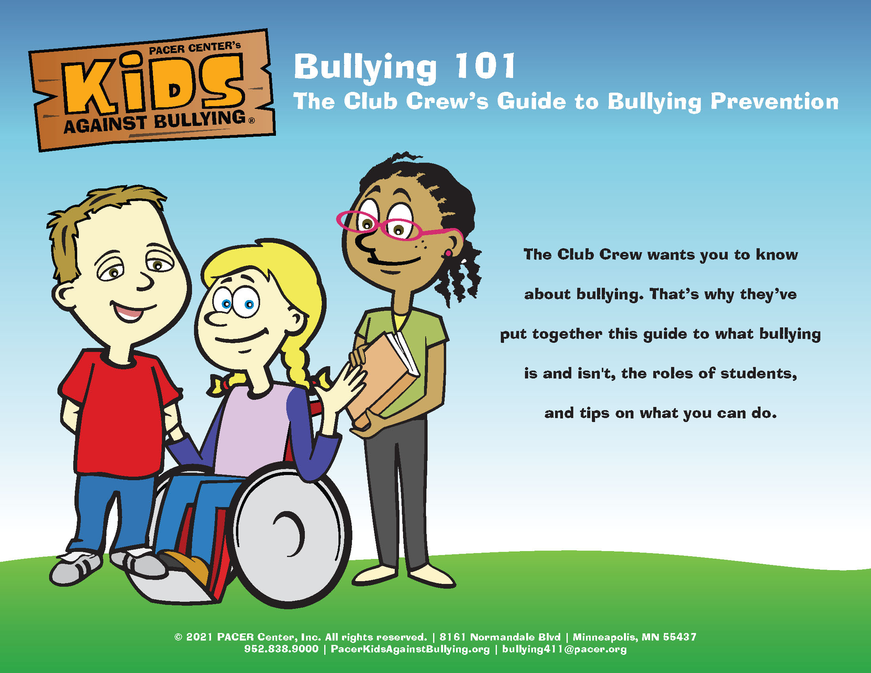
Notes:
Slide title: Cover Slide
Objective: Slide to show onscreen pre-presentation
PACER’s National Bullying Prevention Center
Is a program of PACER Center
8161 Normandale Blvd. | Bloomington, MN 55437
952.838.9000
bullying411@PACER.org
PACER.org/Bullying
Founded in 2006, PACER’s National Bullying Prevention Center actively leads social change, so that bullying is no longer considered an accepted childhood rite of passage. PACER provides innovative resources for students, parents, educators, and others, and recognizes bullying as a serious community issue that impacts education, physical and emotional health, and the safety and well-being of students.
PACER.org/Bullying: This is the portal page for parents and educators to access bullying resources, which include educational toolkits, awareness toolkits, contest ideas, promotional products and more.
PACERTeensAgainstBullying: Created by and for teens, this website is a place for middle and high school students to find ways to address bullying, to take action, to be heard, and to own an important social cause.
PACERKidsAgainstBullying: A creative, innovative and educational website designed for elementary school students to learn about bullying prevention, engage in activities and be inspired to take action

Slide 2
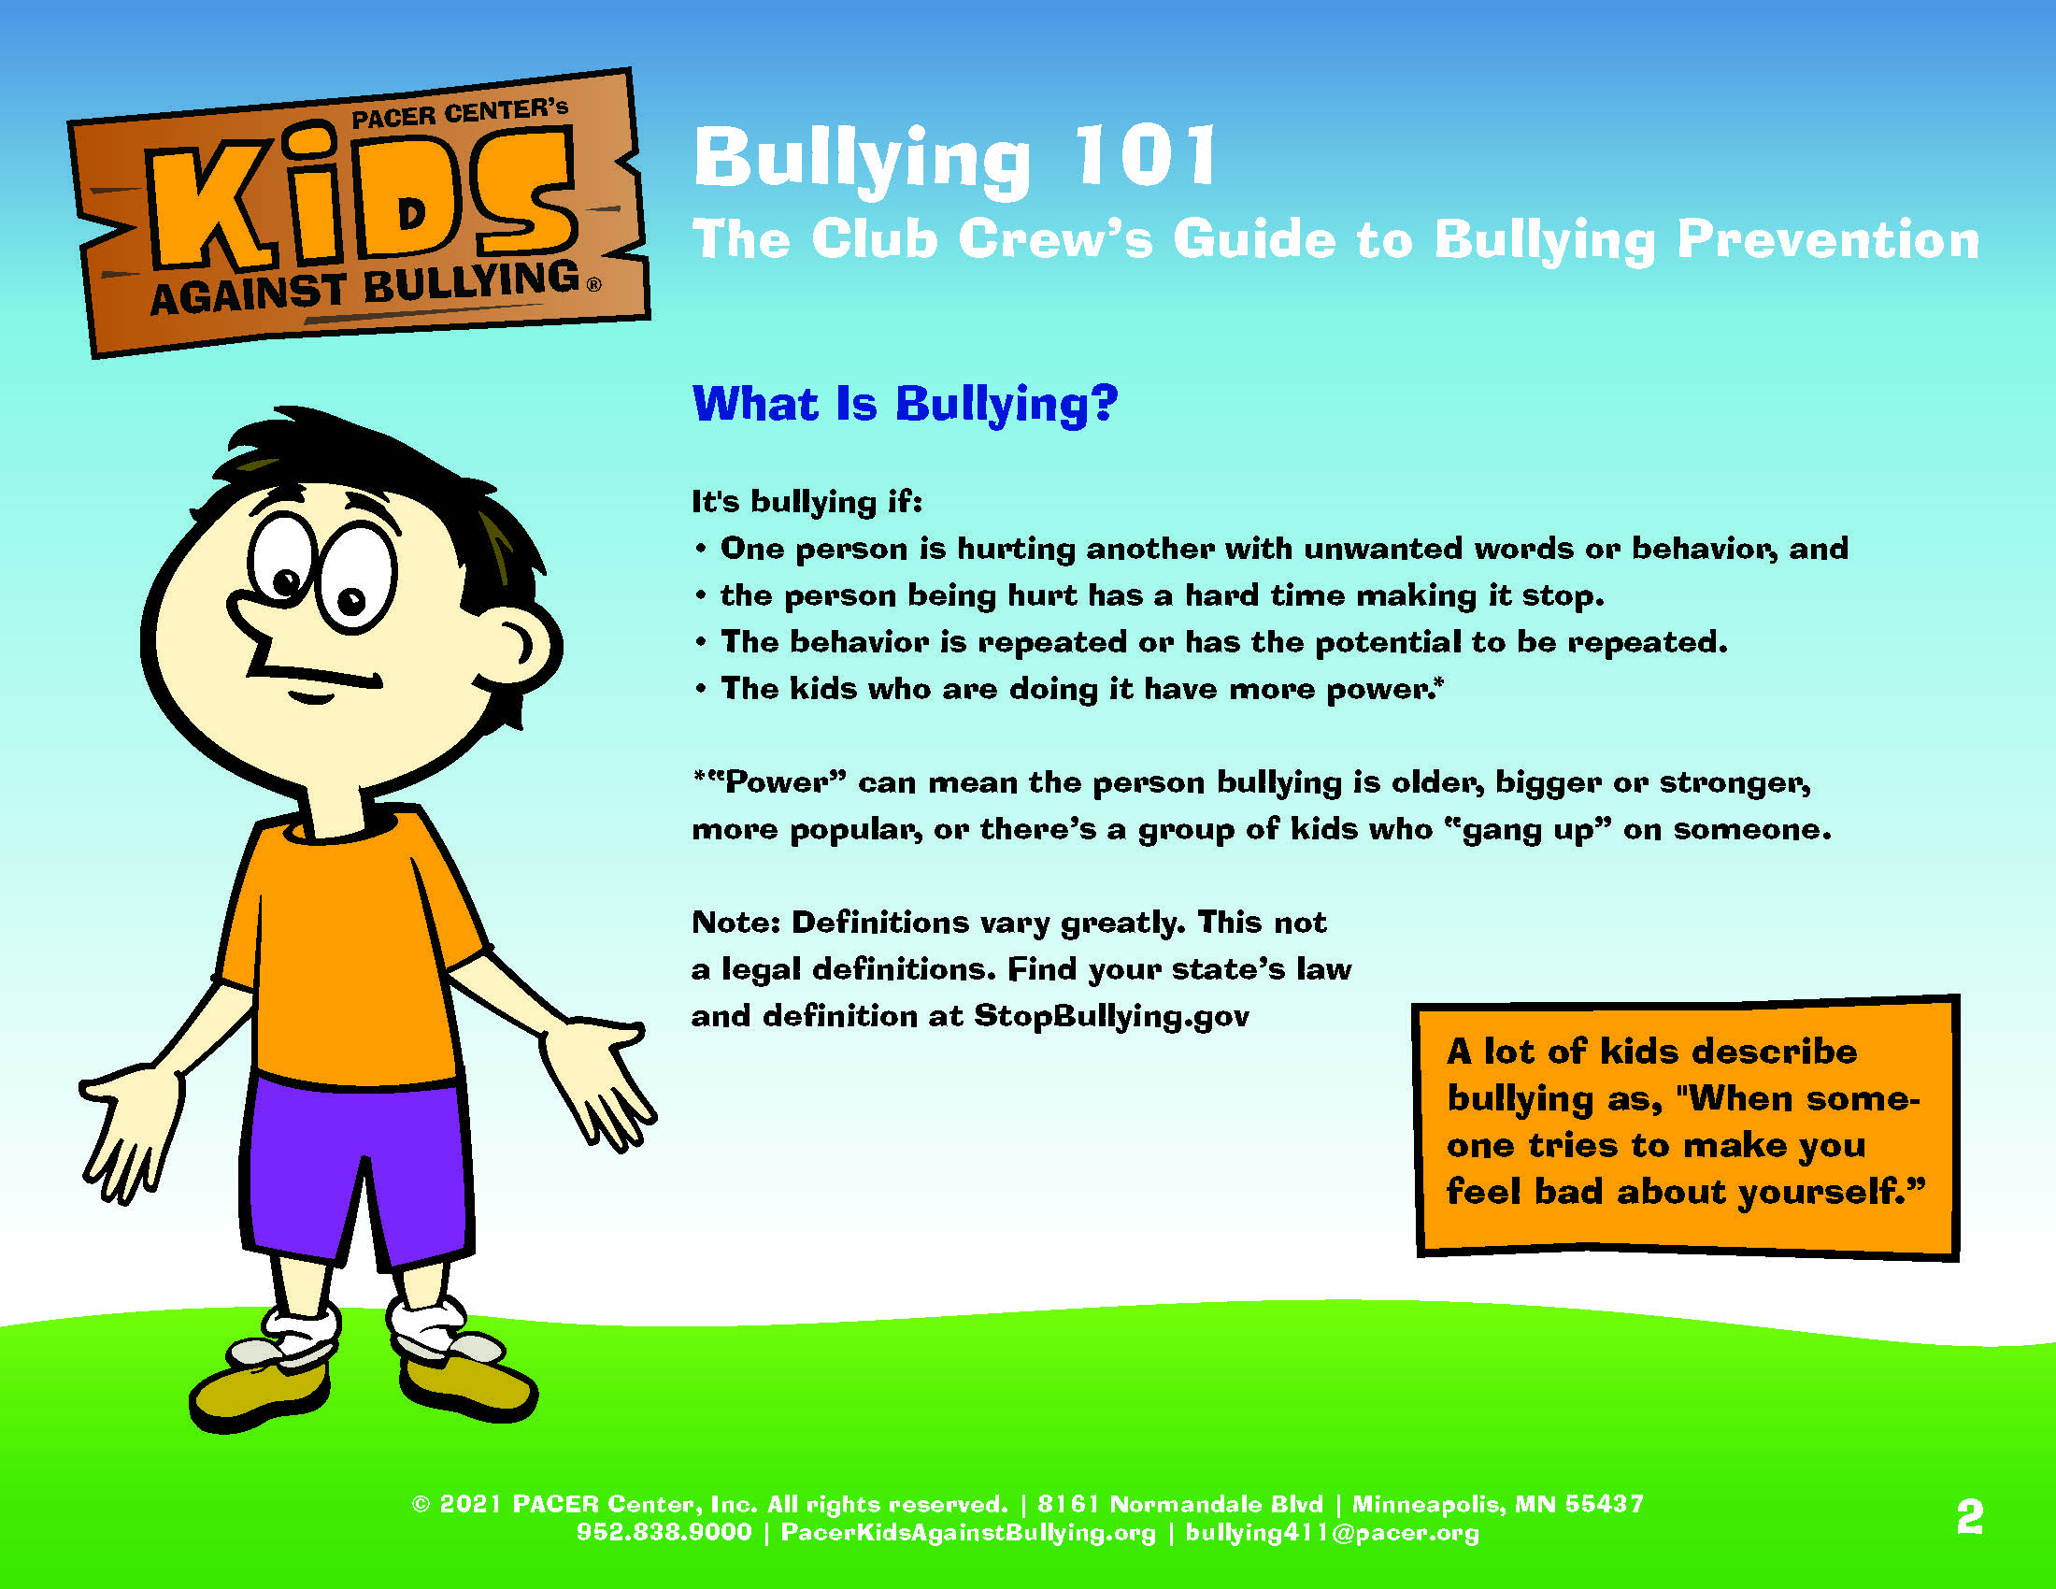
Notes:
Slide title: What is bullying?
Objective: Give students a definition about what bullying is
so they can identify the hurtful or harmful behavior.
Bullying is when someone is being hurt either by unwanted words or actions on purpose, usually more than once, feels bad because of it, and has a hard time stopping what is happening to them.
Other important points to cover in the definition include:
On person is hurting another with unwanted words or behavior, and
the person being hurt has a hard time making it stop.
The behavior is repeated or has the potential to be repeated.
The kids who are doing it have more power.
Power can mean the person bullying is older, bigger or stronger, more popular, or there’s a group of kids who “gang up” on someone.
This may also be a good time to share your school policy’s definition of bullying.
As a discussion question, ask students how they think bullying feels?

Slide 3
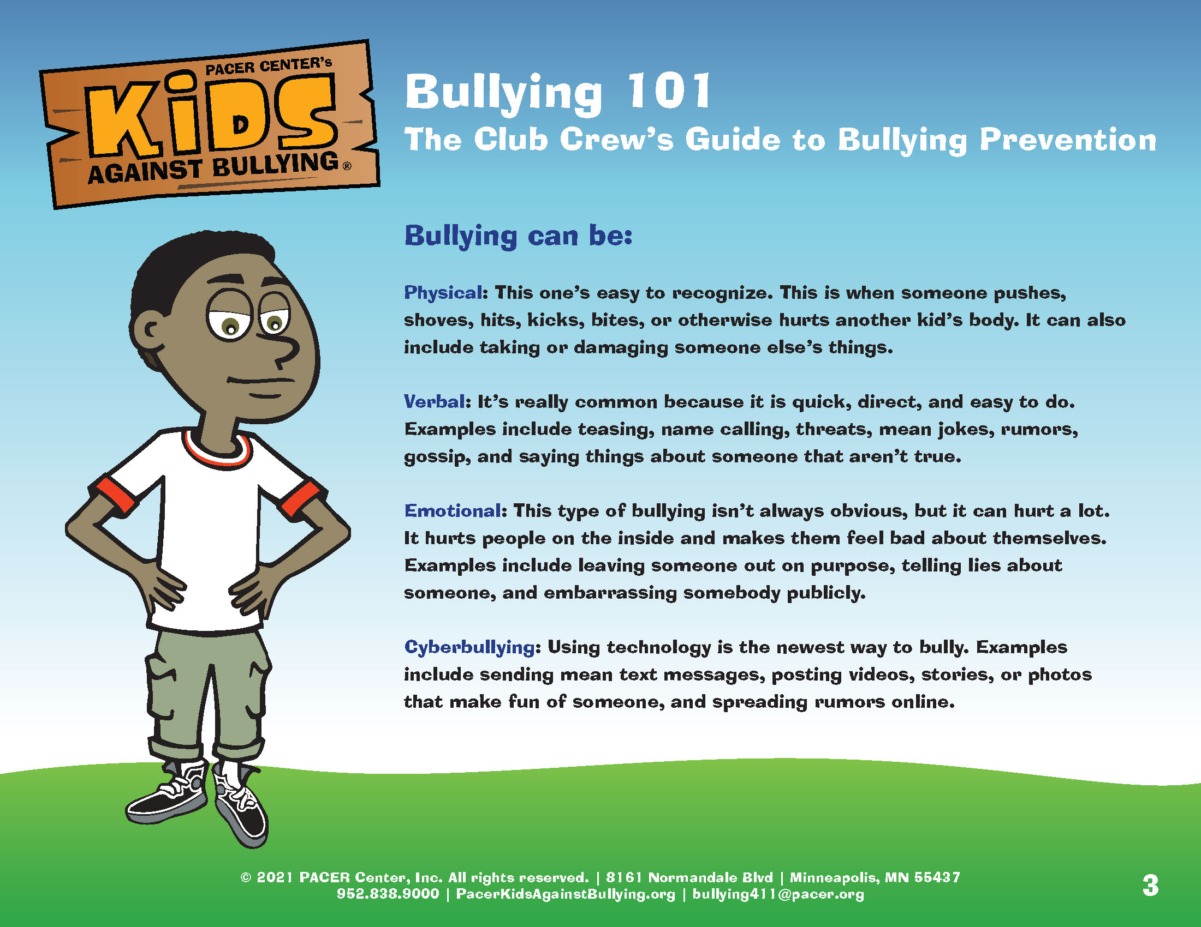
Notes:
Slide title: Types of Bullying
Objective: Students will become more familiar with the
types of bullying.
Physical: Physical bullying can be the easiest type of bullying to recognize, since it is the most visible behavior. With this type of bullying, there is a perceived intent to harm, which can include instances of “pretending” to physically harm the target (ex: flicking fingers close to the target’s eyes or face, causing a withdrawal reaction). Examples of physical bullying include: hitting, pushing, fighting, tripping, making rude gestures, or taking / breaking another person’s things.
Verbal: Verbal bullying is the most common type of bullying. It is quick, direct and can be done in passing. It’s important to remember that verbal bullying is just as hurtful as physical bullying. It can include: teasing, name calling, threats, mean jokes, rumors, gossip, or saying things that aren’t true.
Emotional: This may be a hard type of bullying to detect because it always isn’t obvious – but just as verbal bullying, it’s emotionally hurtful. It can make people feel excluded, isolated and bad about themselves. Examples include: leaving someone out on purpose, telling lies about someone, embarrassing somebody publically, sharing secret, or saying your friends can’t be friends with a new student if they still want to be friends with you.
Cyberbullying: This is the newest way to bully. Cyberbullying is using technology – such as the internet, social media, cell phones, or pictures – to hurt or harm someone else. It include: sending mean text messages, posting statements online that are unkind or not true, sending or posting pictures that aren’t yours to share, making negative comments online about someone, or agreeing with someone who posts something hurtful.
Bullying is NEVER okay, cool, or acceptable.
Discussion question ideas:
What are some other examples of emotional bullying?
What type of bullying do you think happens the most? Why?

Slide 4
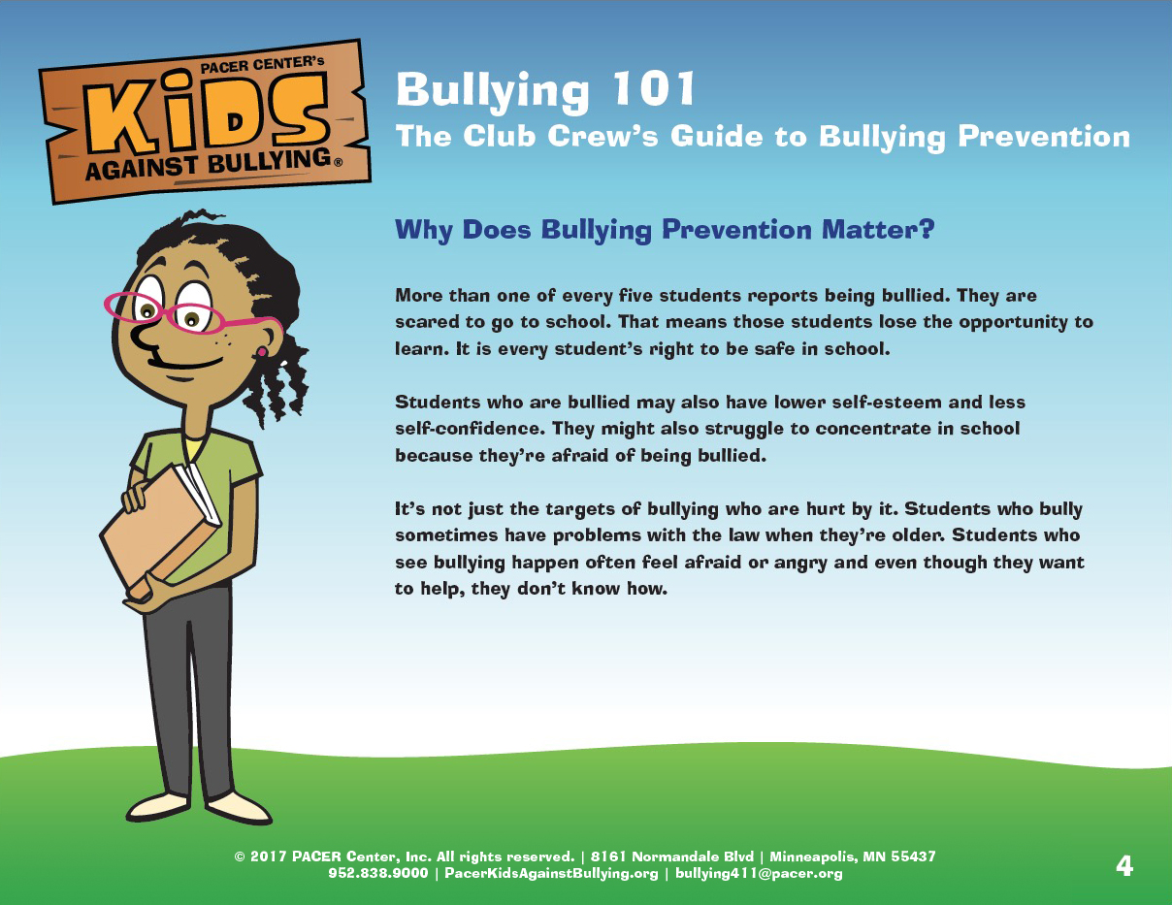
Notes:
Slide title: Why does bullying prevention matter?
Objective: Students will learn why bullying prevention
is important.
When students experience bullying, they often feel alone, isolated and like no one cares. Bullying impacts a student’s education, as they may be scared to go to school or have difficulty concentrating.
It’s not just targets of bullying who are hurt. Students who bully are impacted by their behavior – they may have problems with the law when they’re older. Also, students who witness bullying often feel angry or upset when they see bullying, but don’t know how to help.
Bullying prevention matters because it can help create a kind and safe school environment where everyone is respected. All students deserve to feel safe and supported at school, online, and in their community!
Discussion question: Why do you think bullying prevention is important?

Slide 5
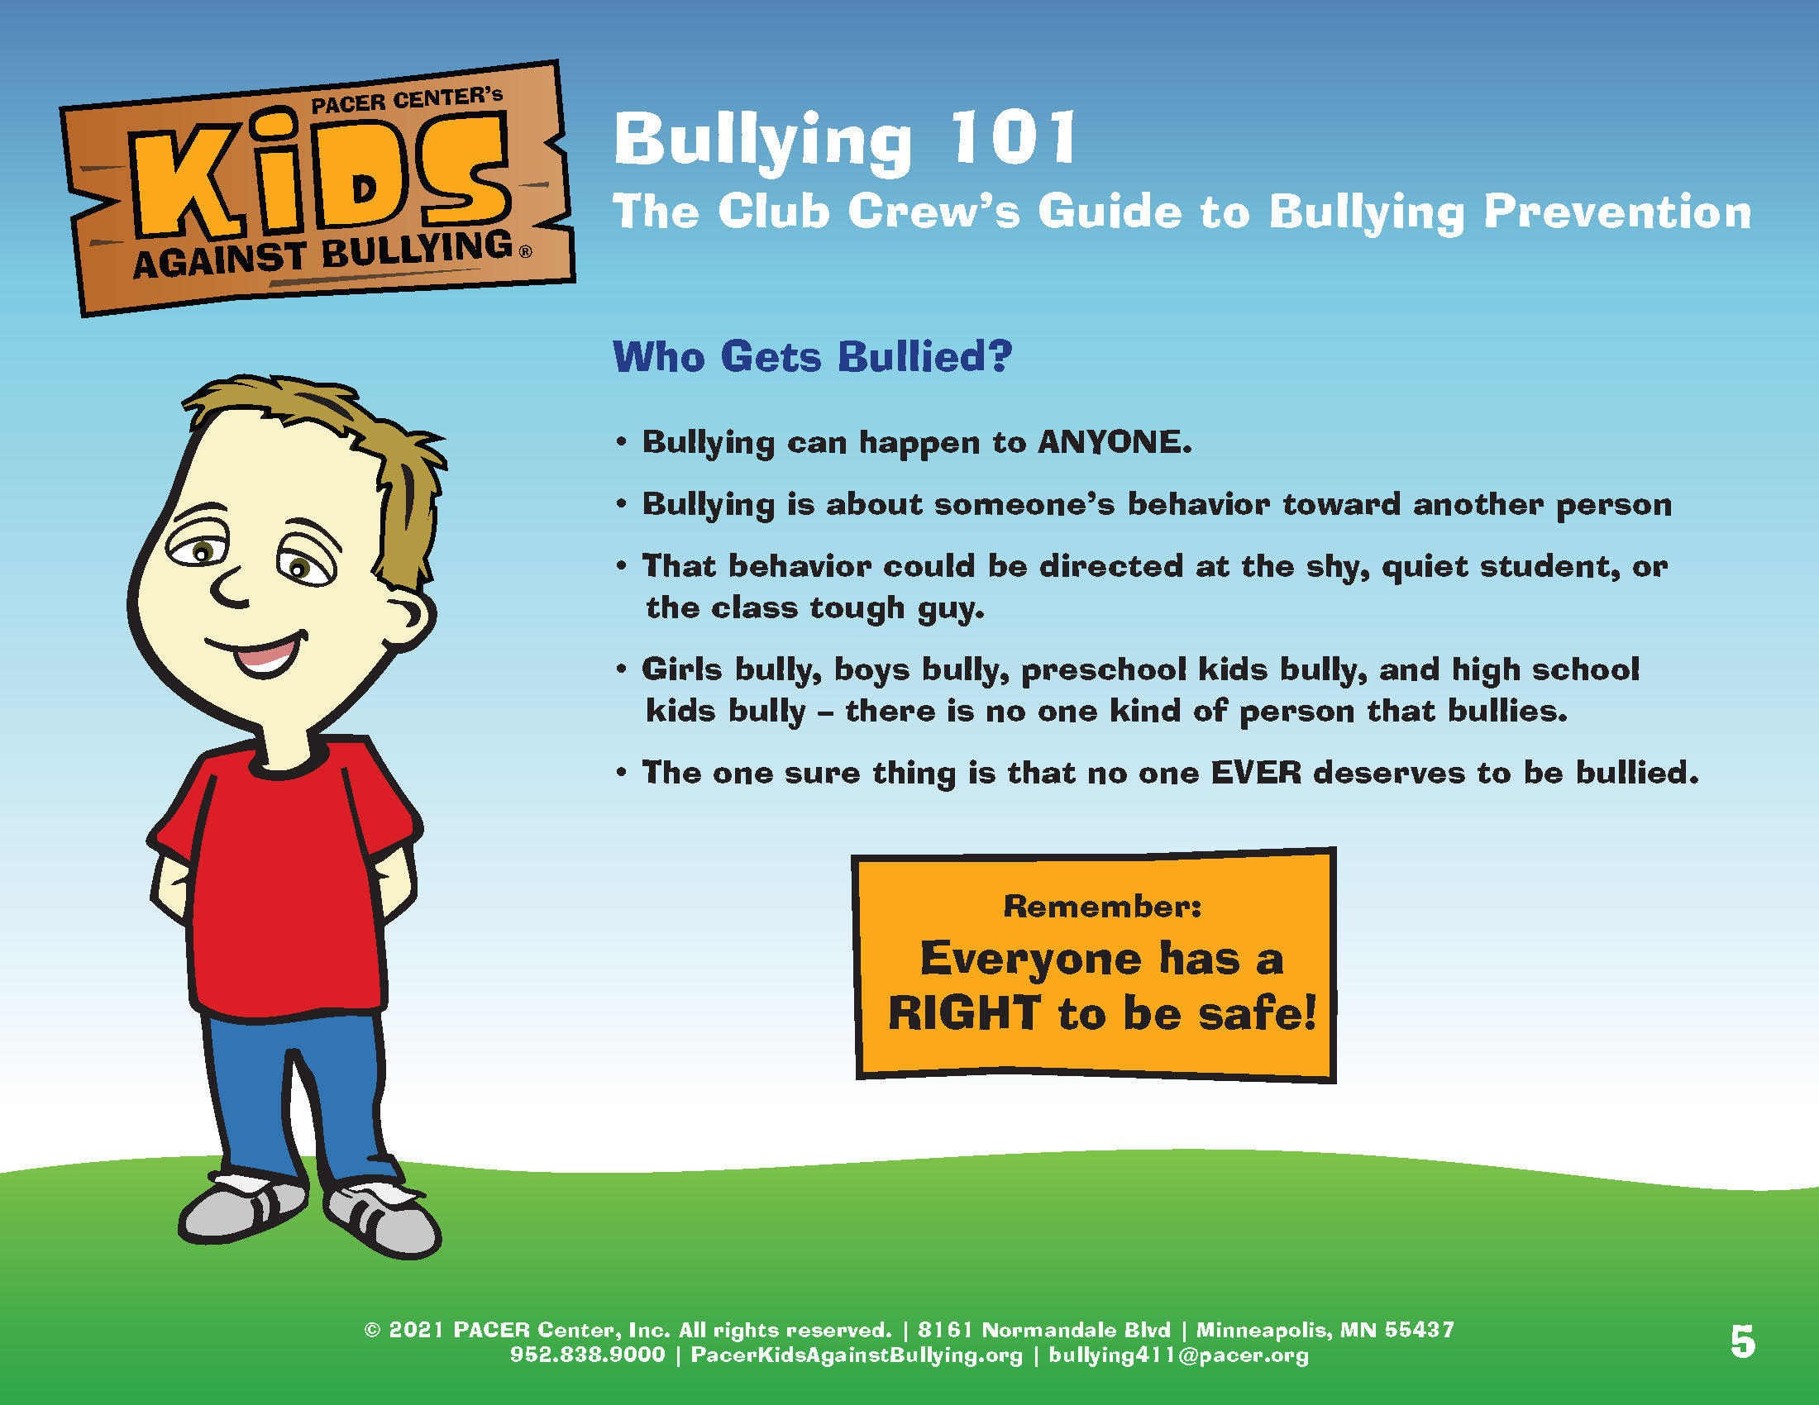
Notes:
Slide title: Who Gets Bullied?
Objective: This slide shows that bullying can
happen to anyone!
Think that bullying only happens to the shy, small kid? In reality, bullying can happen to anyone. It’s all about a behavior – with one person hurting or harming another. This means, it can happen to the shy, quiet students or the class tough guy. Girls, boys, preschool kids, high school teens – anyone can experience bullying.
But it’s important to remember no one ever deserves to be bullied.

Slide 6
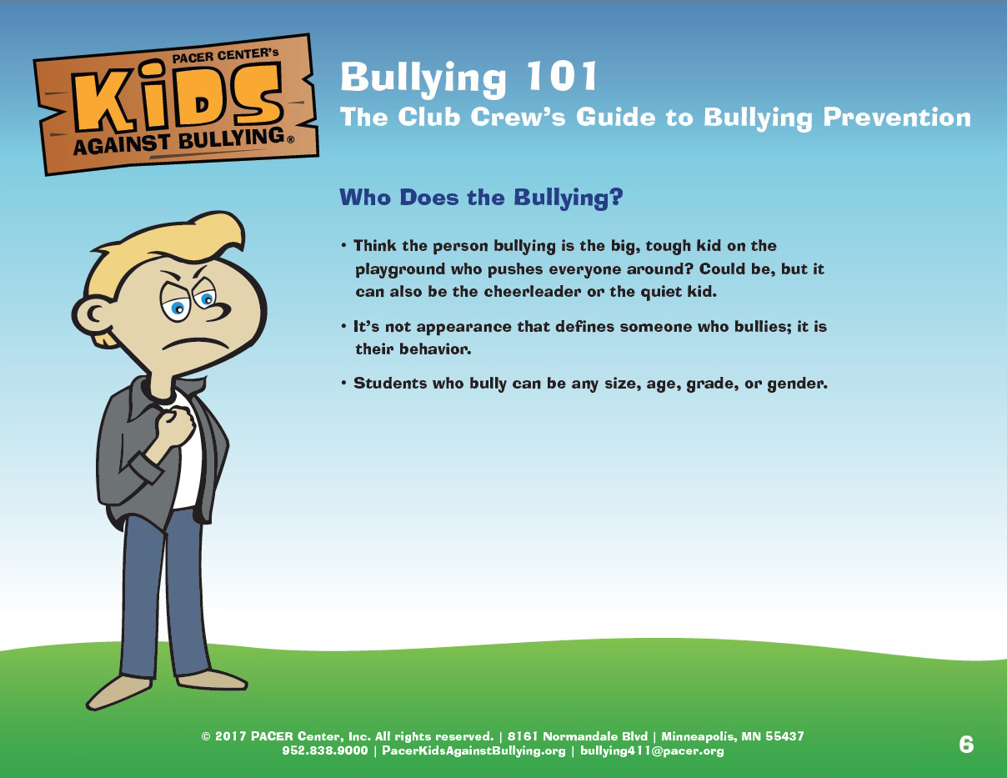
Notes:
Slide title: Who Does The Bullying
Objective: This slide shows that anyone can bully – it’s
all about behavior.
Think bullying is just the big, tough kid on the playground who pushes everyone around? It could be, but it could also be the cheerleader or the quiet kid.
It’s not the appearance that defines someone who bullies, but their behavior. Regardless of how someone looks, if they are hurting or harming another person physically or emotionally, that’s bullying. It can be anyone, of any size, age, grade or gender.
Kids bully for all sorts of reasons. There’s no one reason someone bullies or one kind of person who bullies. Some kids bully because they don’t know how much it’s really hurting the other person, or because they think it makes them look cool. Others believe that some kids deserve to be bullied because they think they’re weak or unpopular. Sometimes the kid who’s bullying is trying to gain control over someone else because there are other things going on in their life that they can’t control. Many kids who bully are actually being bullied themselves as well. These aren’t the only reasons kids choose to bully, but they’re some of the most common ones.

Slide 7
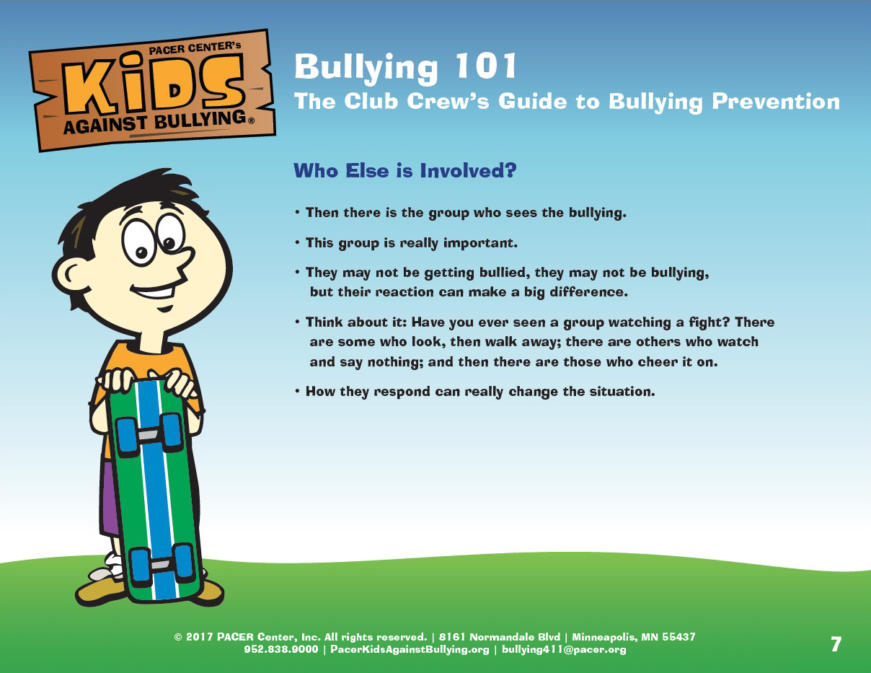
Notes:
Slide title: Who Else is Involved?
Objective: Educate students further about the witness or
bystander role.
The role that a majority of kids play in a bullying situation is the witness – or bystander. This is the group of kids who see bullying happen and play a huge role in preventing bullying. How they respond can really change the situation.

Slide 8
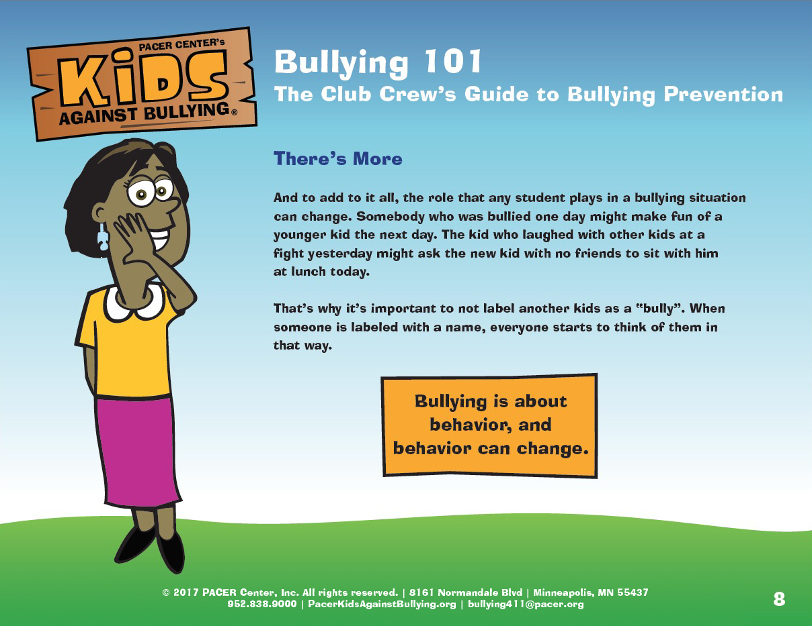
Notes:
Slide: There’s more – roles in bullying
Objective: Show there are different roles that students
can play in a bullying situation and reaffirm that it’s all
about behavior.
There are three roles a student can play in a bullying situation:
The person experiencing bullying
The person doing the bullying
Those that see the bullying happening.
Students can play multiple roles in a bullying situation. For example: somebody who was bullied on the bus in the morning, may bullying another student during lunch. Or the kid who laughed with other kids at a fight yesterday, might ask the new kid with no friends to sit with him at lunch today.
Bullying is ALL about behavior and behavior can change. That’s why it’s important not to label another kid a ‘bully’ or ‘victim’. Their behavior can be changed and redirected to be positive.

Slide 9
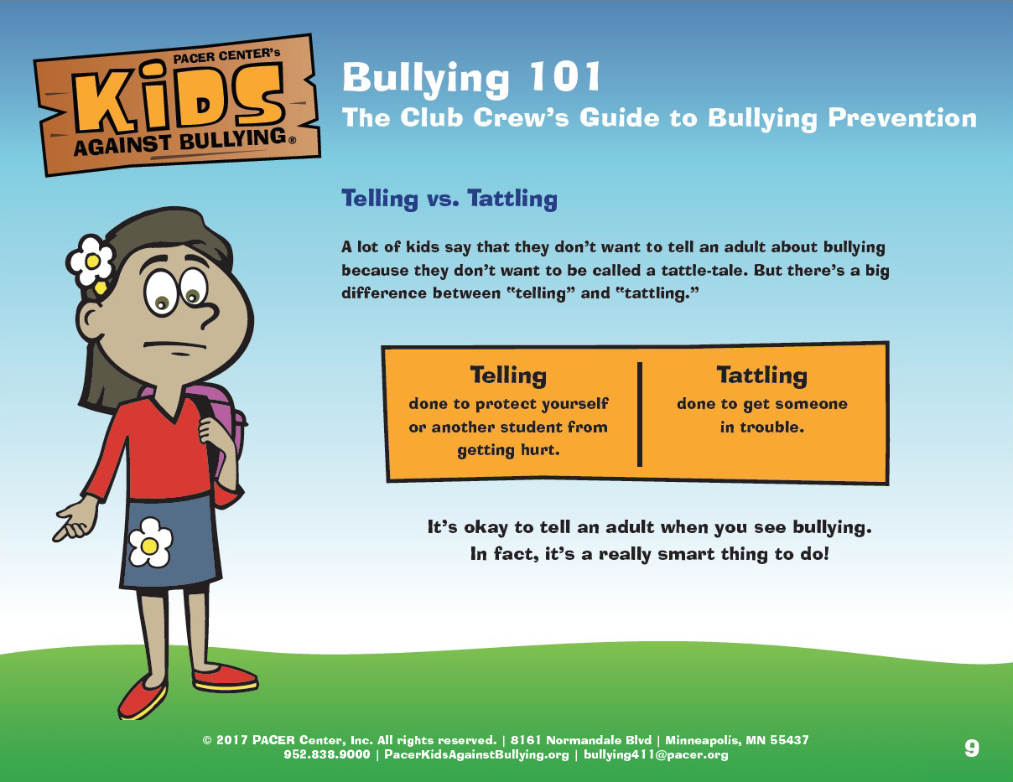
Notes:
Slide title: Telling vs. Tattling
Objective: This slide will help students recognize the
difference between tattling and telling.
A lot of kids say that they don’t want to tell an adult about bullying because they don’t want to be called a tattle-tale. But there’s a big difference between “telling” and “tattling.”
Telling is done to protect yourself or another student from getting hurt. For example, if you or a friend experience bullying, talking with an adult about this would be considered TELLING. You are protecting yourself or your friend, and ensuring your safe at school.
Tattling is done to get someone in trouble. For example, you see someone at your lunch table that doesn’t drink all of their milk and throws it away. Reporting this to an adult may be considered tattling, as you are trying to get the purpose in trouble.
Think – Is your safety or a friend’s safety concerned? Is this problem important? Is someone being hurt or harmed – physically or emotionally?

Slide 10
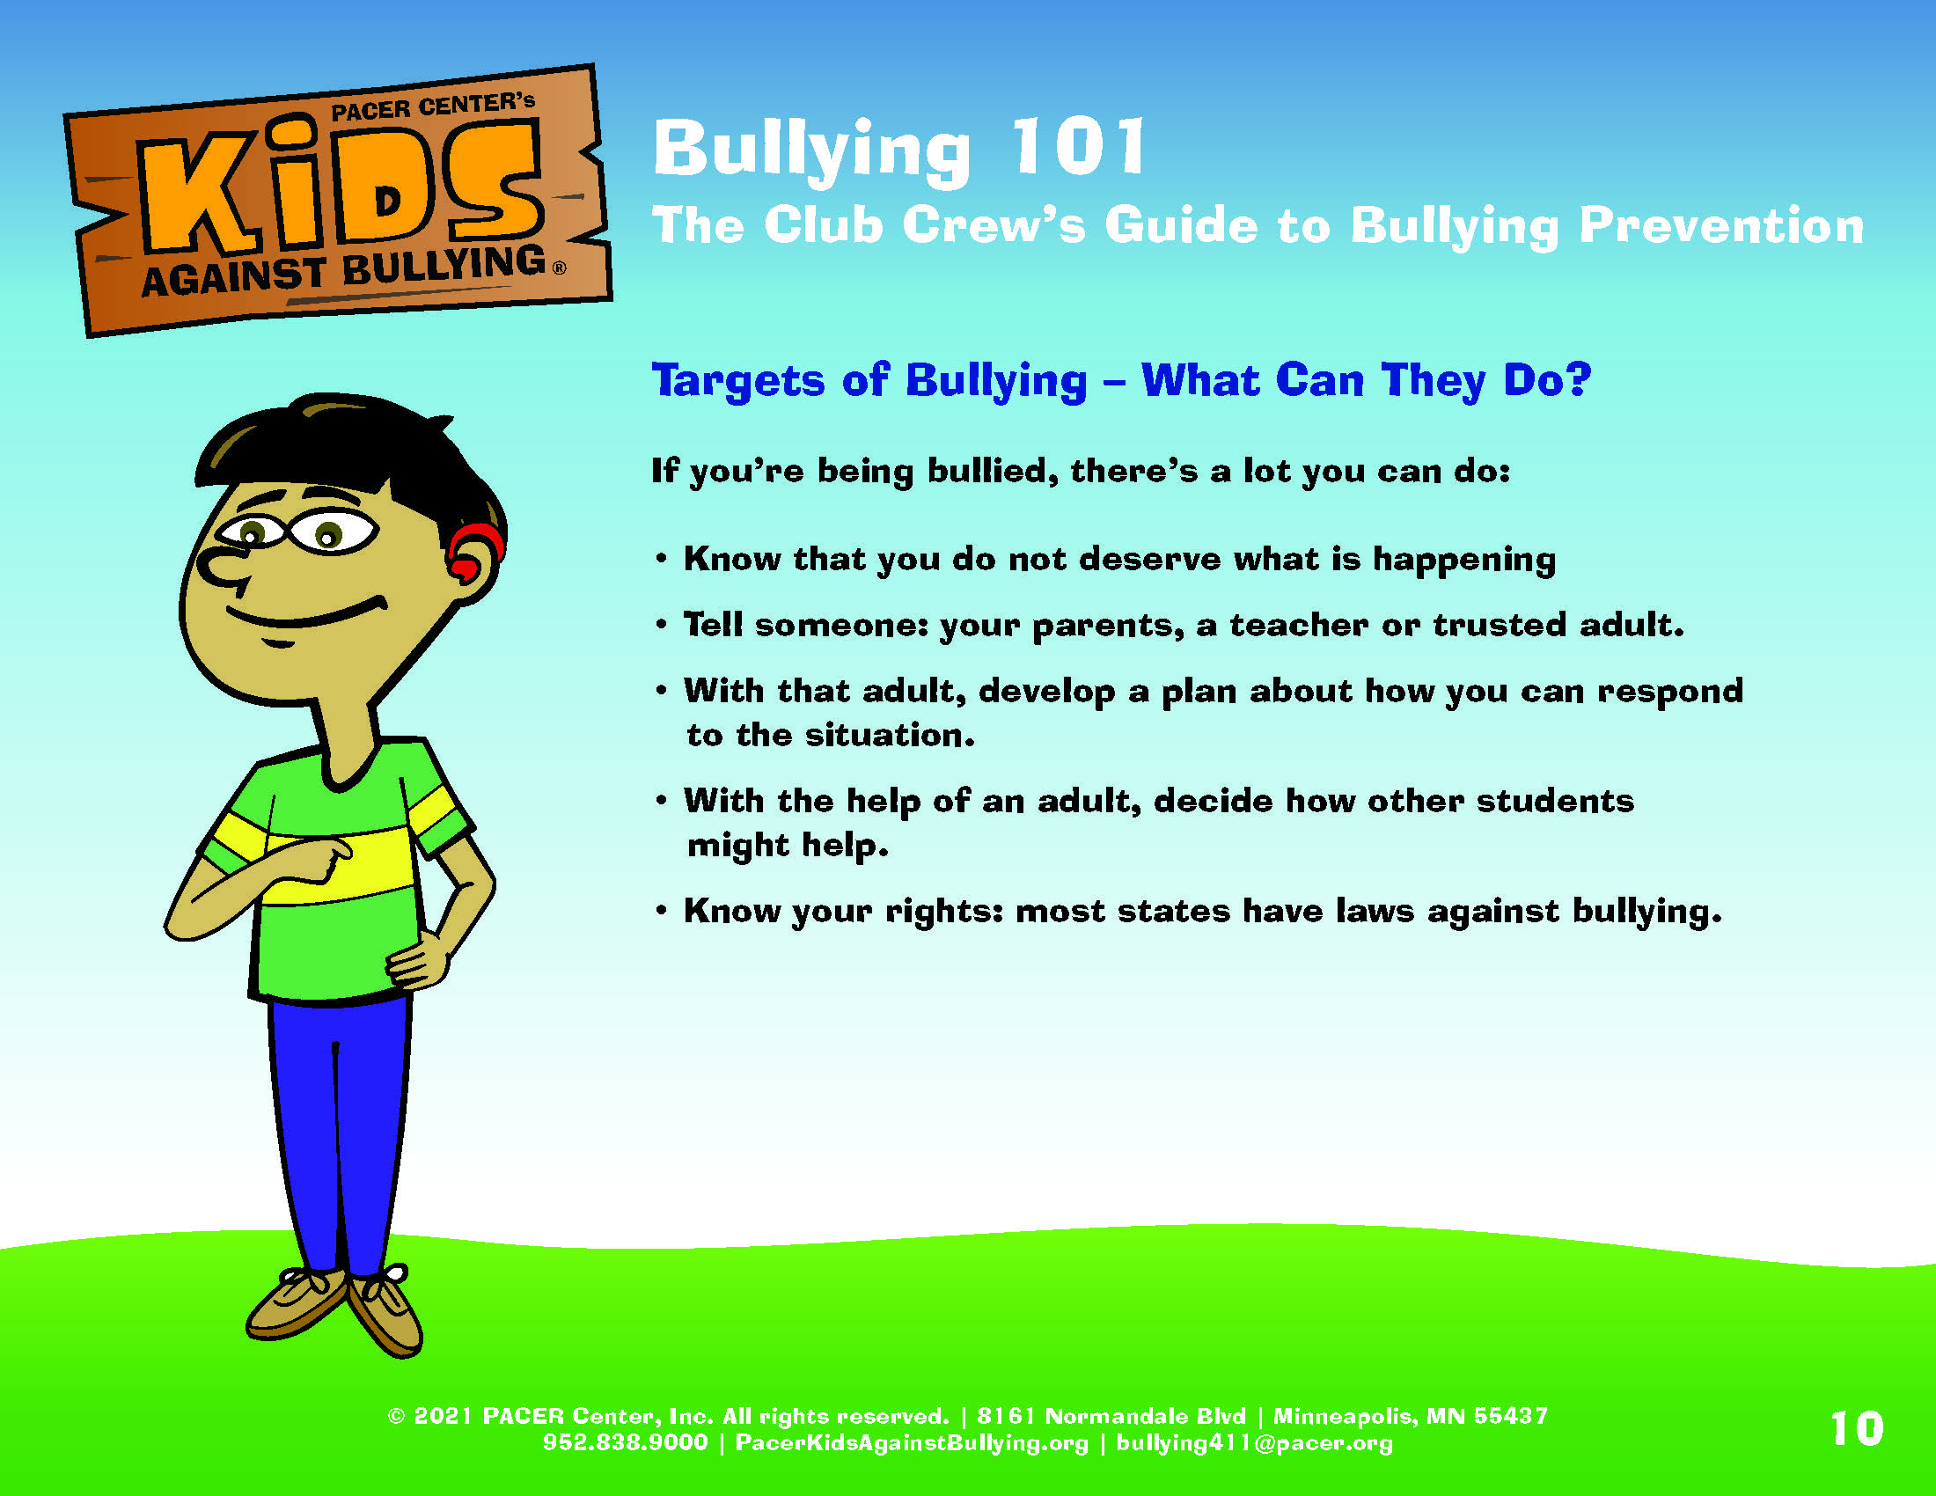
Notes:
Slide title: Targets of Bullying – What Can They Do?
Objective: This slide will give students tips on what they
can do if they experience bullying.
If you are being bullied, the first thing you should know is it’s not your fault. No one deserves to be bullied, ever! And while its never your job to fix what’s happening, there is a lot you can do to take action.
Know that you do not deserve what is happening. A lot of kids are bullied, but that never makes it right. When you are being bullied, it might feel like no one cares or that there is no one that can help. But know this, there are people who care. It might not be easy, but know that you can reach out and ask for help. You don’t have to go through this on your own.
Tell someone: your parents, a teacher or trusted adult. If you’re being bullied, tell an adult right away. It’s not tattling. When you are being hurt or harmed, it’s a big deal. You need someone you can trust on your side. You have the right to tell.
With that adult, develop a plan about how you can respond to the situation. A lot of kids who are bullied don’t want to go to school – or maybe avoid places where the bullying occurs. Talk with your parents or adults at school and ask them “what can we do so that I am safe?” Develop an action plan that includes steps that will help you feel like school is a good place to be.
With the help of an adult, decide how other students might help. Surround yourself with people who care about you and who will speak up for you.
Know your rights: most states have laws against bullying. Ask your teacher or a school administrators about your school’s policy on bullying prevention and how you can stay safe.

Slide 11
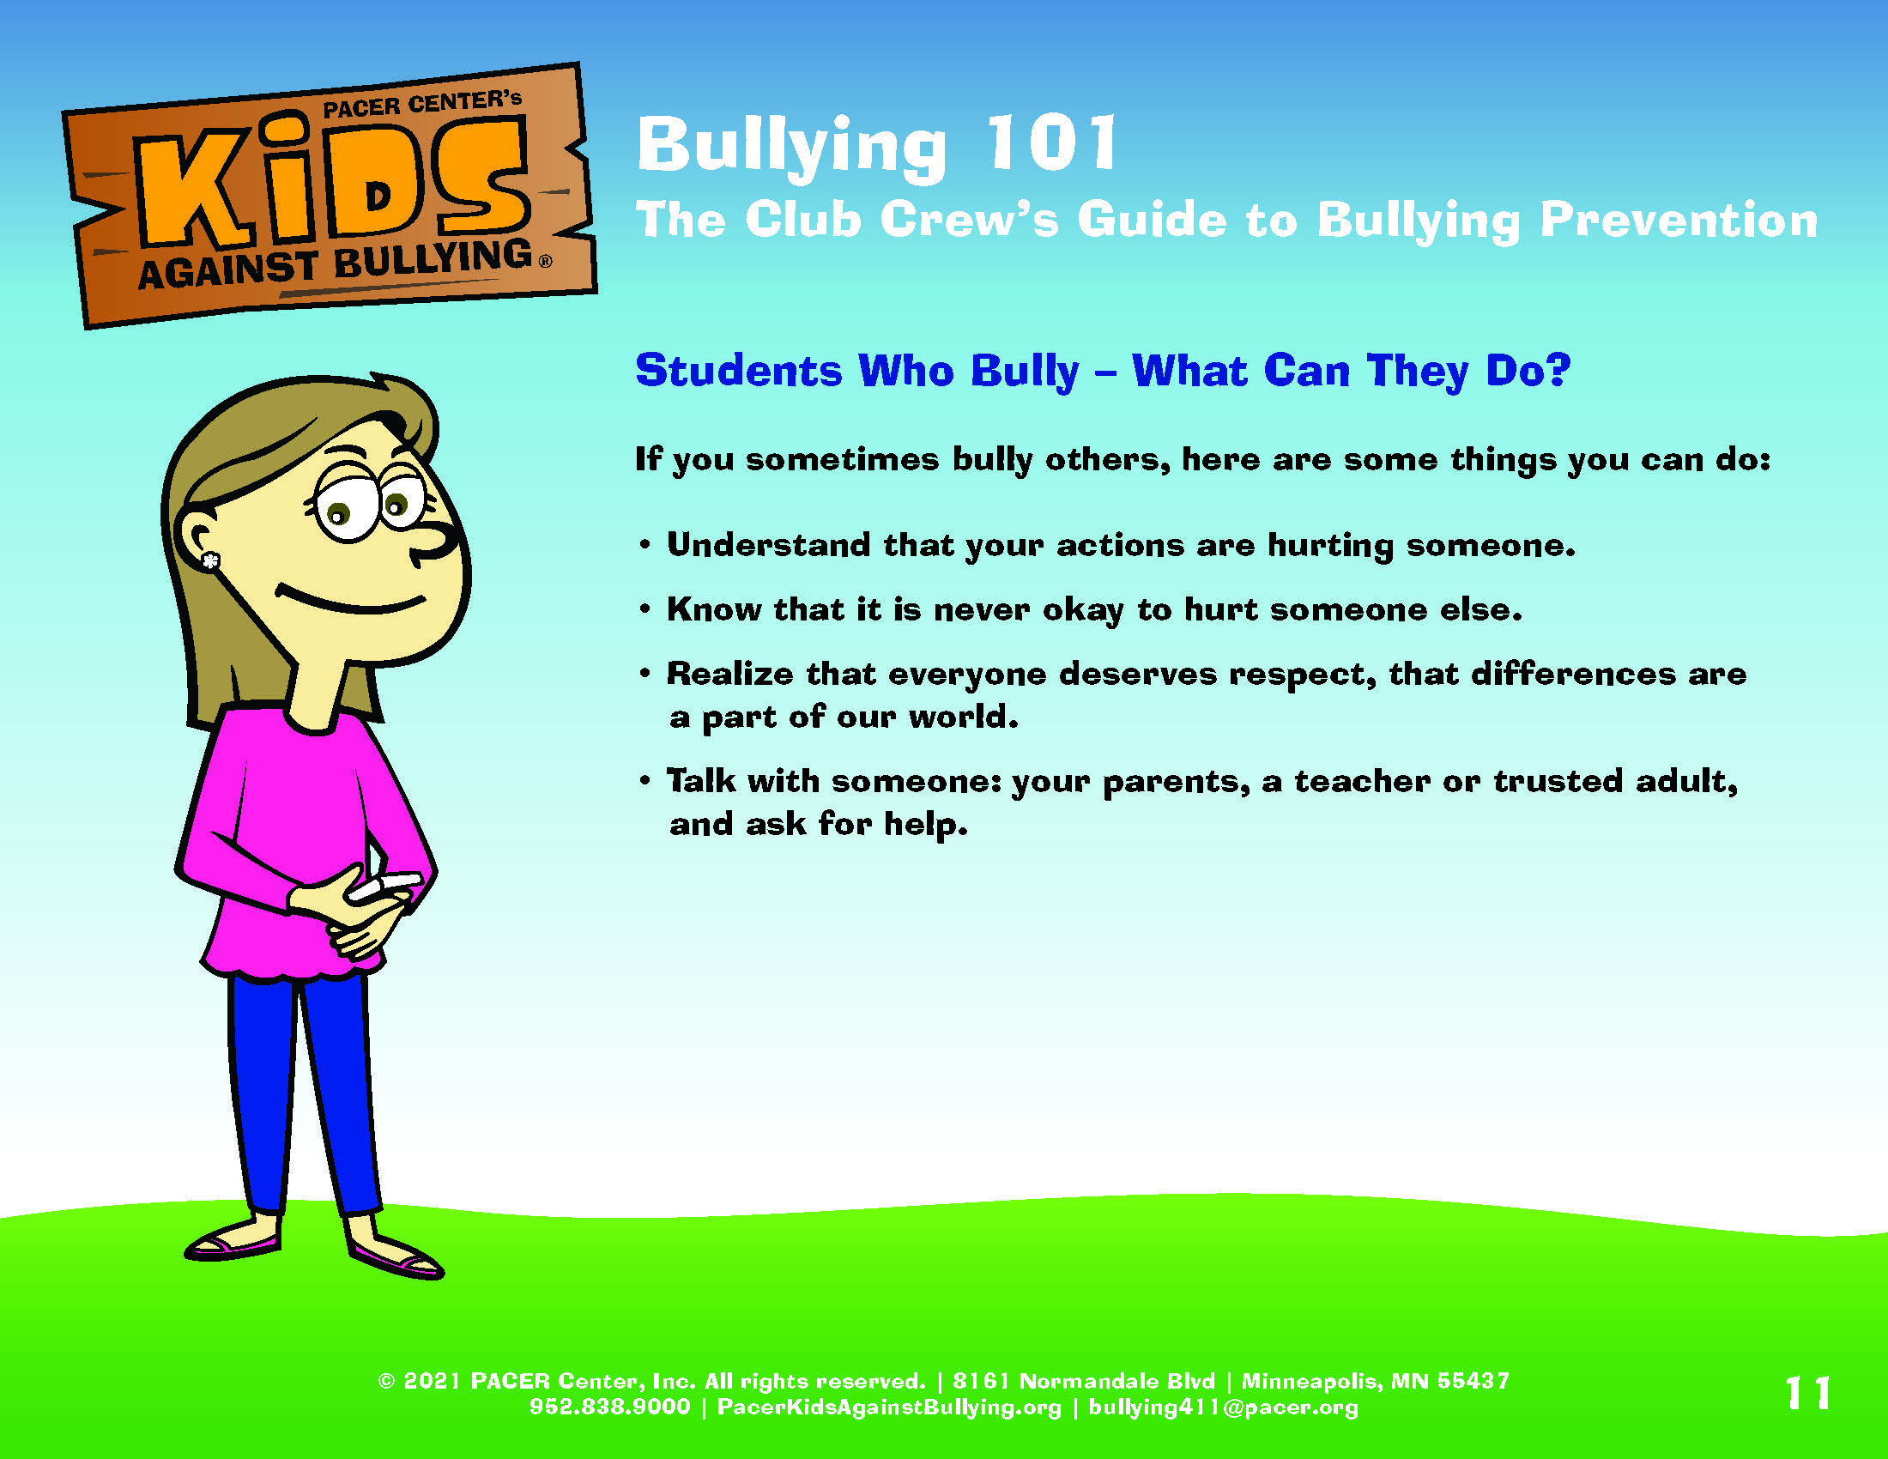
Notes:
Slide title: Students Who Bully – What Can They Do?
Objective: This slide will give students tips on what they
can do if they are demonstrating bullying behavior.
If you are being bullied, the first thing you should know is it’s not your fault. No one deserves to be bullied, ever! And while its never your job to fix what’s happening, there is a lot you can do to take action.
Understand that your actions are hurting someone. Bullying means hurting someone else on purpose. It might seem like maybe you are just having some fun, that unless someone is crying, that no one is being hurt. But even when there are no tears, kids are getting hurt. When someone is hurt, they feel sad, scared and alone. Is that how someone should feel?
Know that it is never okay to hurt someone. Kids may bully for a lot of reasons – to stay part of a group, to feel powerful or in control, are jealous of someone, or may have been bullied by someone else. Whatever the reason, there is nothing cool or fun about hurting someone. Think about other ways to respond that don’t involve bullying.
Realize that everyone deserves respect, that differences are a part of our world. No one deserves to be bullied. Hurting someone for ANY reason is wrong. Kids who look or act different deserve to be treated with the same respect as everyone else. Really, aren’t we all different from each other in some way?
Talk with someone: your parents, a teacher or trusted adult, and ask for help. There are many ways to handle feelings. Talking with someone is one idea—parents, adults at school or a friend—or even the other kid. What are other ways to deal with frustration or being mad?

Slide 12
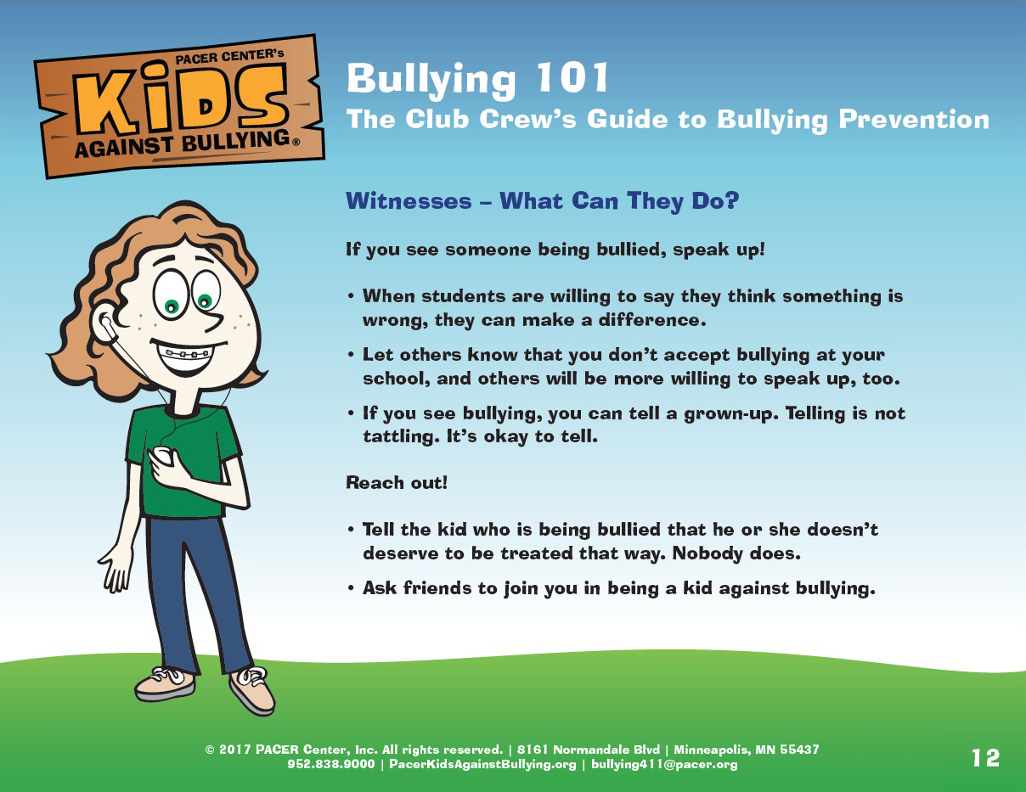
Notes:
Slide title: Witnesses – What Can They Do?
Objective: This slide will give students tips on what
to do if they see bullying happening.
You know the feeling. You see someone being bullied and you feel scared. Or mad. Or sad. Or helpless. You might wonder what you can do to help. Did you know you’re not alone? A lot of kids feel that way about bullying. There are lots of things you can do to help. You could try reaching out as a friend to someone who has been bullied, or standing up for someone by defending them and telling the bully what they are doing is not ok. There are lots of options. Do what feels safe to you. Do what feels ok to you.
What you can do?
If you see bullying, you can tell a grown-up. Adults really do care. They are the ones that can enforce the rules. It can be done while the bullying is happening or after. Remember: telling is NOT tattling, it is done to help someone.
Tell the kid who is being bullied that he or she doesn’t deserve to be treated that way. Kids who are bullied often feel alone, like no one cares, like it might even be their fault. Let them know that someone cares.
Ask friends to join you in being a kid against bullying. When kids stick together and don’t accept bullying, they can change what has happened to so many for so long. Together we can make a difference.
Other ideas include:
Help get them away from the situation. It is easy for someone to be bullied when no one sticks up for them. Be a friend. Walk with them to class, play with them on the playground, and let them know they’re not alone.
Not join in. Someone who bullies often likes an audience, it makes it more fun for them. If you ignore the bullying, it shows them it’s not cool. Be a kid against bullying.
Even a small act helps make a difference. When kids stand together against bullying, they can make their classroom, their school, where they live and even the world a better place!

Slide 13
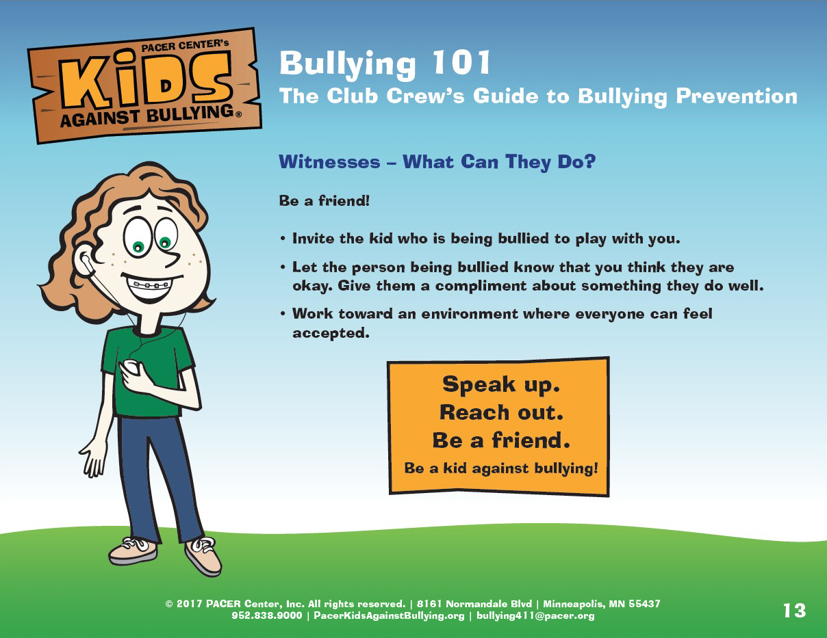
Notes:
Slide title: Witnesses – What Can They Do? – Continued.
Objective: This slide will continue to give students tips
on what to do if they see bullying happening.
Be a friend
Invite the kid who is being bullied to play with you, sit with you at lunch, or join you in an activity. So often, kids who experience bullying feel like they are all alone. Show them that you are there for them!
Let the person being bullied know that you think they are okay. Give them a compliment about something they do well – such as the science project they did about volcanos or the awesome soccer tricks you saw them do during recess.
Work towards an environment where everyone can feel accepted. This can be including peers during recess, holding the door open, or introducing yourself to a new peer.
Discussion questions:
How do you think being a friend to all helps prevent bullying?
What other ideas do you have about ways to support a peer experiencing bullying?

Slide 14
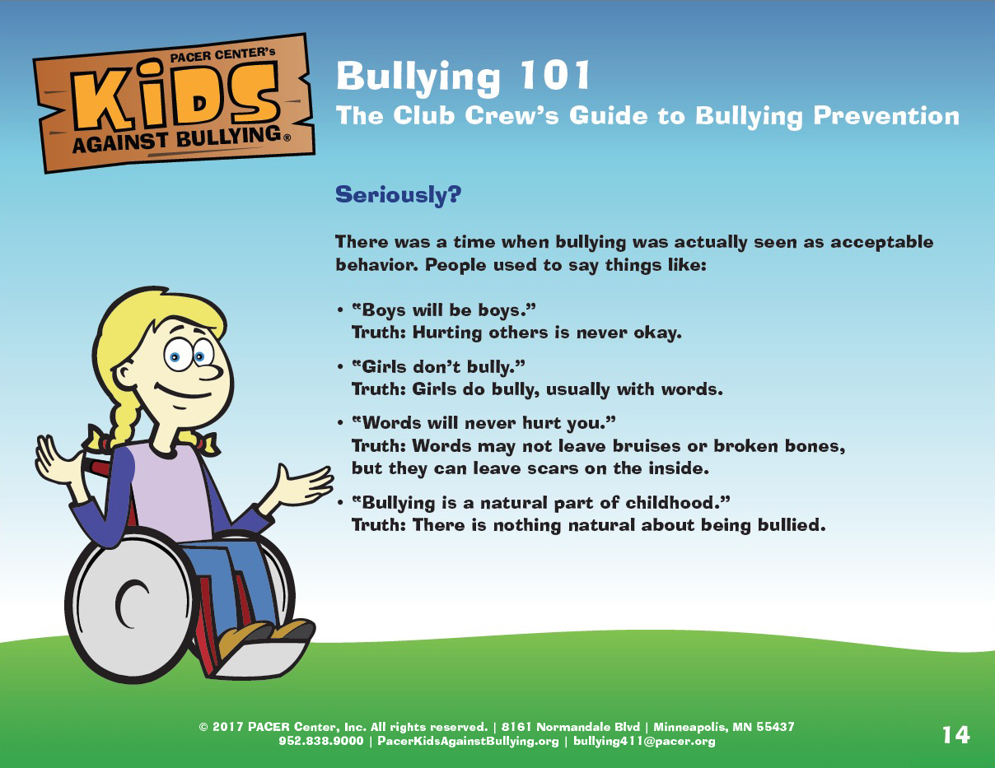
Notes:
Slide title: Seriously? Common myths about bullying
Objective: There are often myths about bullying –
the purpose of these next 2 slides are to talk about
myths and the truths that really exist.
Boys will be boys. But really… hurting others is never okay.
Girls don’t bully. But really… girls can and do bullying. While they may not physically bully, they often use words for verbal bullying.
Words will never hurt you. But really… verbal bullying hurts just as much as physical bullying. Although it doesn’t leave bruises or scars, it really hurts emotionally.
Bullying is a natural part of childhood. But really… there is nothing natural about being bullied. Everyone deserves to be safe and supported at school.

Slide 15
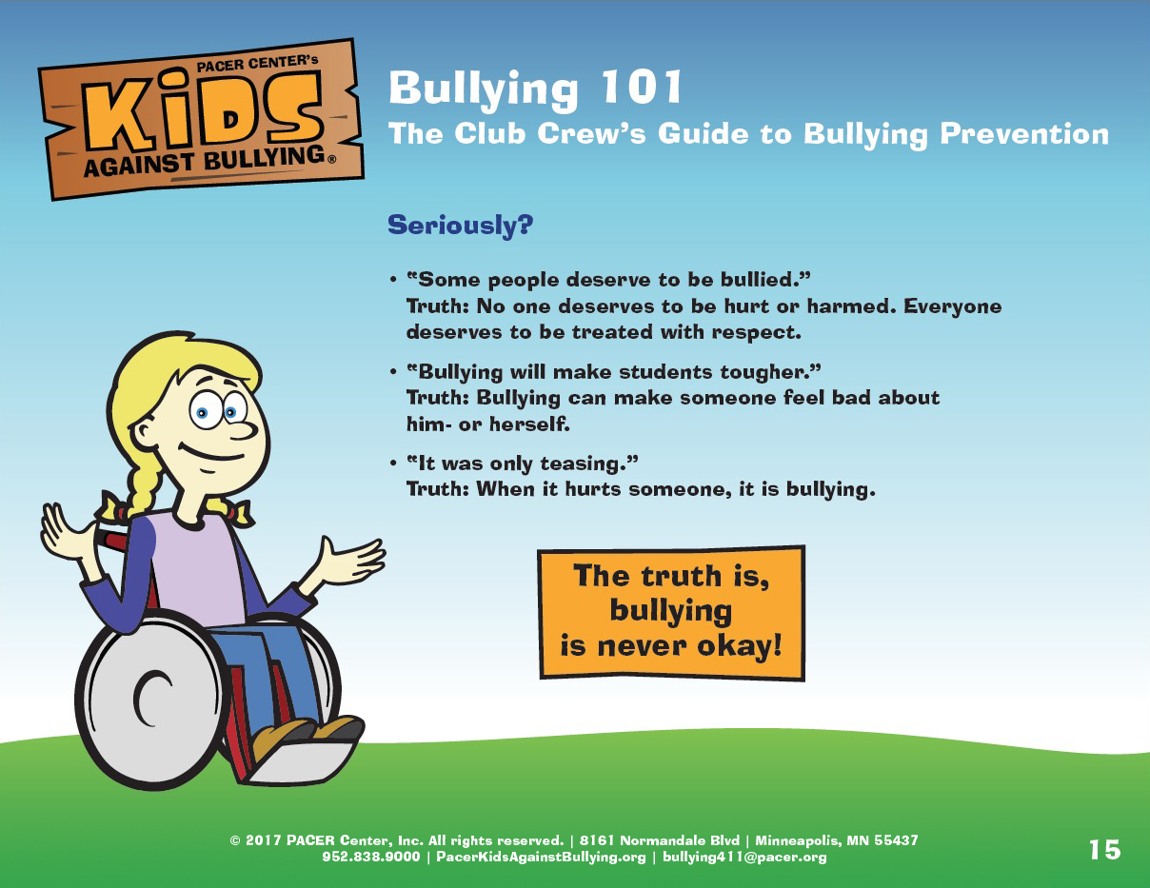
Notes:
Slide title: Seriously? Common myths about bullying –
Continued
Objective: There are often myths about bullying –
the purpose of these next 2 slides are to talk about
myths and the truths that really exist.
Some people deserve to be bullied. But really… no one deserves to be hurt or harmed. Everyone deserves to be treated with respect. Differences or behaviors never constitute bullying.
Bullying will make students tougher. But really… bullying does not make someone tougher. It’s shown that bullying actually can have the opposite effect and make a student feel less confident and create fear.
It was only teasing. But really… when it hurts someone, it’s bullying. Teasing doesn’t hurt someone – bullying does.
Discussion questions: What else have you heard about bullying that you think isn’t true?

Slide 16
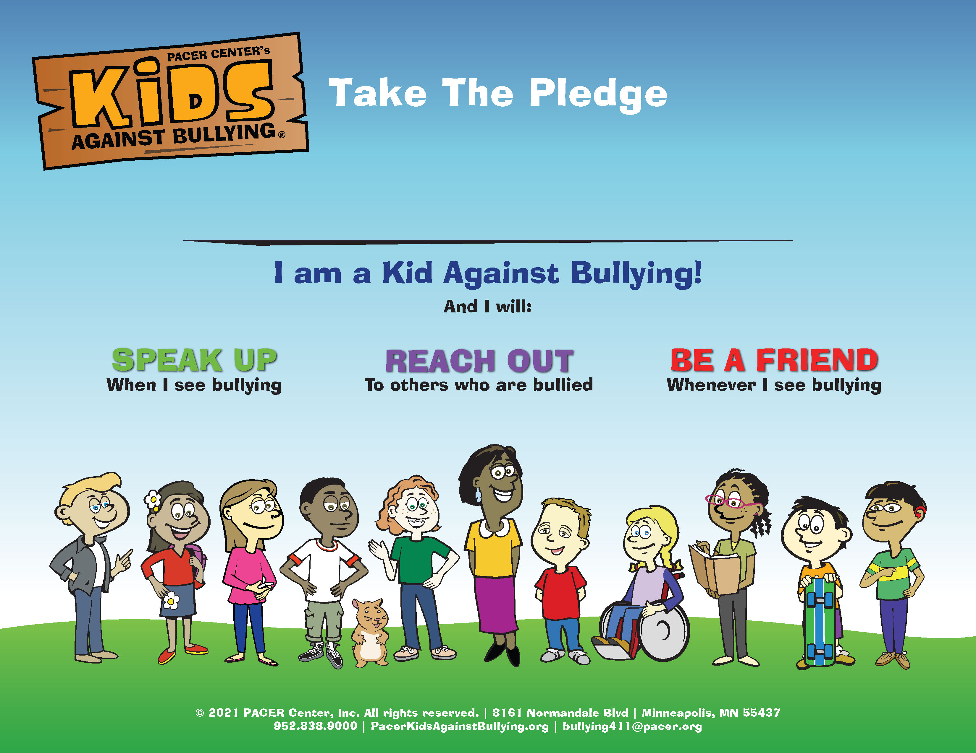
Notes:
Slide title: Take The Pledge!
Objective: Wrap up the presentation by taking the
pledge together. Ask students if they have any further
questions about bullying.

