Slide 1


Bullying 101:
Guide for Middle and High School Students
A guide to the basics of bullying, what it is and isn’t, the role of students, and tips on what you can do in response to it.
Notes:
Slide title: Cover Slide
Objective: Slide to show onscreen pre-presentation
PACER’s National Bullying Prevention Center
Is a program of PACER Center
8161 Normandale Blvd. | Bloomington, MN 55437
952.838.9000
bullying411@PACER.org
PACER.org/Bullying
Founded in 2006, PACER’s National Bullying Prevention Center actively leads social change, so that bullying is no longer considered an accepted childhood rite of passage. PACER provides innovative resources for students, parents, educators, and others, and recognizes bullying as a serious community issue that impacts education, physical and emotional health, and the safety and well-being of students.
PACER.org/Bullying: This is the portal page for parents and educators to access bullying resources, which include educational toolkits, awareness toolkits, contest ideas, promotional products and more.
PACERTeensAgainstBullying: Created by and for teens, this website is a place for middle and high school students to find ways to address bullying, to take action, to be heard, and to own an important social cause.
PACERKidsAgainstBullying: A creative, innovative and educational website designed for elementary school students to learn about bullying prevention, engage in activities and be inspired to take action

Slide 2


What Is Bullying?
A lot of teens describe bullying as, "When someone tries to make you feel less about who you are as a person, and you aren’t able to make it stop.”
Bullying is more than disagreements, differences of opinion, or conflicts that occur between friends and classmates.
Bullying definitions typically include:
• The target is being hurt or harmed by unwanted words or behavior
• The hurtful behavior is repeated or there is a concern that it will be repeated
• The target being hurt has a hard time stopping or preventing the unwanted behavior
• The hurtful behavior is carried out by those who have more (real or perceived) power, which is used to control or harm others.
Power can mean students who are older, are physically stronger, have access to embarrassing information, have more social status, or are part of a group that is singling out an individual.
Note: This is not a legal definition, but rather a way to help understand and identify bullying. For your school’s definition, check the district’s bullying prevention policies. For a legal definition, consult your state’s law on bullying at StopBullying.gov.
Notes:
Slide title: What is Bullying?
Objective: Gives students a definition about what bullying is to help recognize it.
Bullying definitions typically include:
• The target is being hurt or harmed by unwanted words or behavior
• The hurtful behavior is repeated or there is a concern that it will be repeated
• The target being hurt has a hard time stopping or preventing the unwanted behavior
• The hurtful behavior is carried out by those who have more (real or perceived) power, which is used to control or harm others. Power can mean students who are older, are physically stronger, have access to embarrassing information, have more social status, or are part of a group that is singling out an individual.
Note: This is not a legal definition, but rather a way to help understand and identify bullying. For your school’s definition, check the district’s bullying prevention policies. For a legal definition, consult your state’s law on bullying at StopBullying.gov.
Discussion question: Ask students what their definition of bullying is? How does it feel to see bullying?

Slide 3


How Is Someone Bullied?
Bullying can be:
Physical: This one can be easy to recognize. Examples include pushing, shoving, hitting, kicking, biting, hair pulling, inappropriate touch, breaking objects, and taking or damaging another’s stuff.
Verbal: It’s really common because it’s quick, direct, and easy to do without catching the attention of adults. Examples include teasing, name calling, threats, intimidation, demeaning jokes, rumors, gossip, and slander.
Emotional: This type of bullying can be subtle and difficult to detect. It’s calculated and can be perpetuated by a single person, but it is more often done by a group. It’s targeted at a person’s sense of self, causing them to question their self-worth. Examples include leaving someone out on purpose, telling lies to hurt someone’s reputation, and humiliating someone publicly.
Sexual: Not everyone thinks of unwanted sexual contact or comments as bullying. It’s also often difficult to talk about as it can be very personal and confusing. It can include using demeaning words about someone’s gender or sexuality, unwanted or inappropriate touching or physical contact, sharing personal information about relationships or posting inappropriate photos online.
Cyberbullying: Using technology to hurt or harm someone. Examples include sending mean text messages, making fun of someone’s post, sharing videos or photos that humiliate someone, “trolling” someone to the point of harassment, or spreading rumors or gossip.
Notes:
Slide title: How is someone bullied?
Objective: Go in-depth about the five types of bullying a student may experience.
Physical
This one’s easy to recognize. Examples include pushing, shoving, hitting, kicking, biting, hair pulling, inappropriate touching, breaking objects, and taking or damaging another’s possessions.
Verbal
It’s really common because it is quick, direct, and easy to do. Examples include teasing, name calling, threats, intimidation, demeaning jokes, rumors, gossip, and slander.
Emotional
This type of bullying is more sophisticated. It’s calculated and often done by a group. This is nasty stuff. It hurts people on the inside and makes them feel bad about themselves. Examples include leaving someone out on purpose, telling lies to hurt another person’s reputation, and humiliating somebody publicly.
Sexual
This one is something that not everyone thinks of as bullying. It can include using words that demean someone about their gender or sexuality, inappropriate touching of body parts, unwelcome physical contact, or even posting inappropriate photos online.
Cyberbullying
Using technology is the newest way to bully. Examples include sending mean text messages, posting videos, stories, or photos that ridicule someone, and spreading rumors through social networking sites.
Discussion question: What type of bullying do you think happens most often? Ask students for other examples?

Slide 4
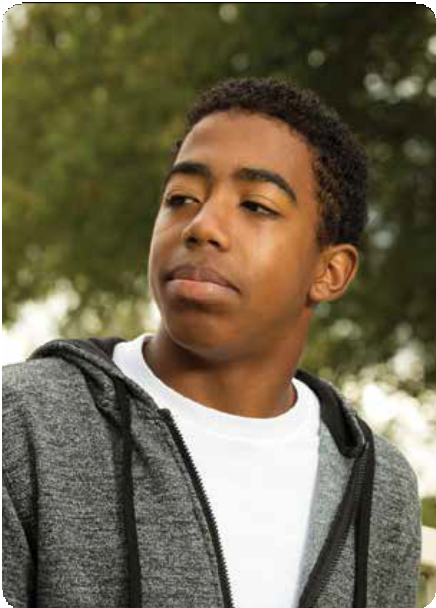

Who Is Involved?
Bullying can happen to anyone.
Bullying is about someone’s behavior. That behavior could be directed at the shy, quiet student or the class tough guy. Research shows that students who are perceived to be different in some way are an increased risk of being bullied. However, it’s important to recognize that bullying can happen to anyone. The one sure thing is that no one ever deserved to bullied, it is never their fault, and if someone is being bullied, they have a right to be safe.
So who bullies?
While there are stereotypes about those who bullying, it’s not appearance that defines who bullies; it’s behavior.
  Bullying is an action, not a personality trait.
Students who bully can be any size, age, grade, or gender. There is no single characteristic or personality trait that indicates who bullies others.
Notes:
Slide title: Who is involved?
Objective: Cover that bullying is all about BEHAVIOR vs. appearance.
Bullying can happen to ANYONE. Bullying is about someone’s behavior. That behavior could be directed at the shy, quiet student, or the class tough guy. Girls bully, boys bully, preschool kids bully, and high school kids bully – there is no one characteristic or aspect that indicates who gets bullied. The one sure thing is that no one EVER deserves to be bullied, it is NEVER their fault, and if someone is being bullied, they have a RIGHT to be safe.
Supportive, diverse environments can help prevent bullying. However, students who are perceived to be different in some way – whether that be their disability, race, sexual orientation, gender, body shape, etc. – are at increased risk for being bullied. It’s important to remember that even though these particular groups of students are especially vulnerable to bullying, and therefore need special protections, school policies need to protect ALL students. No one EVER deserves to be bullied.
So who bullies? Think the person bullying is the big guy who wears black, has low self-esteem, and gets mad a lot? Could be, but it can also be the petite cheerleader or the quiet honor student. It’s not appearance that defines someone who bullies; it is behavior. Students who bully can be any size, age, grade, or gender.

Slide 5
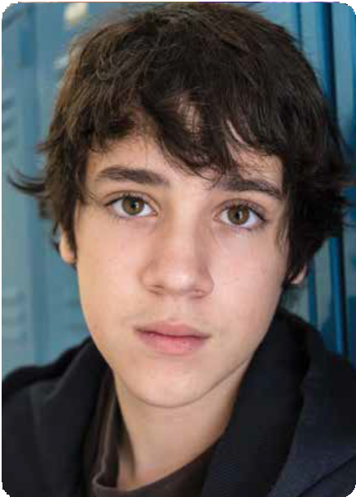

Who Is Involved?
Who witnesses bullying?
Almost all kids see bullying happen at some point.
They may not be getting bullied nor the ones doing the bullying, but witnesses are important because their reactions can have a direct impact on the bullying situation.
  Think about it: Have you ever seen a group watching a fight? There are some who look, then walk away; there are others who watch and say nothing; and then there are those who cheer it on. These responses make a huge difference in the outcome of every bullying situation.
Can someone play more than one role?
The role that any student plays in a bullying situation often shifts and changes from day to day. Somebody who was bullied one day, might make fun of a younger kid the next day. The kid who laughed with other kids at a fight yesterday, might ask the new kid with no friends to sit with him at lunch today.
Notes:
Slide title: Who is Involved
Objective: Cover the ‘witness’ or bystander role and why it’s important + the dual roles in bullying
Then there is the group who sees the bullying and this group is really important. They may not be getting bullied, they may not be bullying, but their reaction has a direct impact on the situation. Think about it: Have you ever seen a group watching a fight? There are some who look, then walk away; there are others who watch and say nothing; and then there are those who cheer it on. These responses make a huge difference in the outcome of every bullying situation. This group is called the bystanders or witnesses.
Nearly 60% of bullying situations stop when a peer intervenes. This powerful statistic shows the important influence peers can have.
While talking about the roles of bullying, note that the role any student plays in a bullying situation often shifts and changes from day to day. Somebody who was bullied on the bus in the morning, might be the one who makes fun of a younger kid that afternoon. The kid who laughed with other kids at a fight yesterday, might ask the new kid with no friends to sit with him at lunch today.

Slide 6
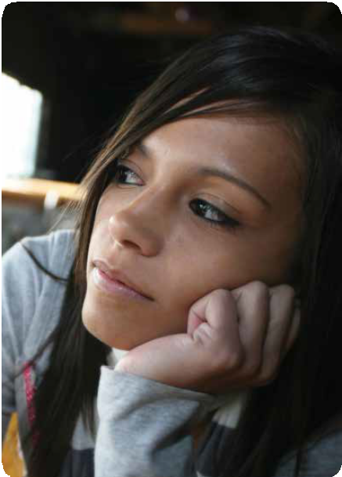

Why Does It Matter?
In the United States, more than 20% of students report being bullied.
That’s more than one of every five students. They are often scared to go to school. That means those students lose the opportunity to learn. It is every student’s right to feel safe—and be safe—in school. Students who are bullied may also have lower self-esteem, less self-confidence, increased fear and anxiety, more depression, lower grades, and even suicidal thoughts.
It’s not just the targets of bullying who are affected. Students who bully grow up to have a greater risk of getting in trouble with the law. By the age of 25, one in four who have bullied will have spent time in jail.
Those who witness bullying often express that they feel less safe at school. Their feelings about seeing the bullying range from anger to guilt to fear, and they often wish they could help but don’t know how.
Notes:
Slide title: Why Does it Matter?
Objective: Share more about the impact bullying can have and why it matters.
This year in the United States, one of out every five students reported they experienced bullying. They are often scared to go to school. That means those students lose the opportunity to learn. It is every student’s right to feel safe – and be safe – in school.
Students who are bullied may also have lower self-esteem, less self-confidence, increased fear and anxiety, depression, lower grades, and even suicidal thoughts.
It’s not just the targets of bullying who affected. Students who bully grow up to have a greater risk of getting in trouble with the law. By the age of 25, one in four who have bullied will have spent time in jail.
Those who witness bullying often express that they feel less safe at school. Their feelings about seeing the bullying range from anger to guilt to fear, and they often wish they could help but don’t know how.
Discussion question: Ask students why they think bullying prevention matters? How do you think it makes a difference?

Slide 7


What If I’m Being Bullied?
First, know that:
No one ever deserves to be bullied
You have the right to ask for help to stop the behavior
Your opinion about what to do to is important
You don’t have to go through the bullying experience alone
Next, think through how to advocate for yourself. What is advocacy?
Self-advocacy means communicating on your own behalf, letting others know what you need, and taking action in a direct and respectful manner. Being your own advocate means that you ask for what you need while respecting the needs of others.
With bullying, learning self-advocacy skills is important because it helps you:
Obtain what is helpful for you
Be involved in the decision-making process
Learn to say “no” and be OK with it
Respectfully express disagreement or differing opinion
Help express your ideas to prevent any bullying you’re experiencing
Notes:
Slide title: What If I’m Being Bullied?
Objective: Share tips about what to do if you experience bullying, specifically around self-advocacy.
Self-advocacy means communicating on your own behalf, letting others know what you need, and taking action in a direct and respectful manner.
Being your own advocate means that you ask for what you need while respecting the needs of others.
For example, if you are at a store and a clerk ignores you, you are able to ask in a polite way to be served.
With bullying, learning self-advocacy skills is important as it helps you.
Obtain what is helpful for you
Be involved in the decision-making process
Learn to say “no” and be OK with it
Respectfully express disagreement or differing opinion
Help express your ideas to prevent any bullying you’re experiencing
Being a “self-advocate” means speaking up for yourself, telling people what you need, and taking action.

Slide 8


What If I’m Being Bullied?
There are three important steps to take:
1. Tell someone, especially an adult
Bullying thrives on silence. Those who bully depend on their targets being silent, as it allows their behavior to continue without consequences. As difficult as it might be to talk about it, it’s important to connect with someone and share what you are going through. Ideally, you’ll talk about it with a parent or an adult you trust.
2. Develop your own action plan
Being a self-advocate means speaking up for yourself and letting people know what you need. Set things in motion by working through a plan:
  Write down what is happening to you, when and where it takes place, and who is involved
  List your role in this action plan, who else should be involved, and what they could do
  Share this information with a parent and an adult you trust at school.
3. Assert your rights
Every student has the right to feel safe at school. If one adult isn’t able to help you, don’t give up! It is your right to talk with another adult, such as a parent. When you do speak with a person you trust, share your action plan and ask “What can be done so I feel safe and other kids do, too?”
Notes:
Slide title: What If I’m Being Bullied?
Objective: Share tips about what to do if you experience bullying
1) Talk with an adult:
Those who bully depend on their targets being silent, as it allows their behavior to continue without consequences. Your natural reaction to bullying might be to isolate yourself from peers and family; it may be too painful, hurtful, or embarrassing to even talk about. And yes, it can be really hard to talk about what’s happening. As difficult as it might be, it’s important to connect with someone and share what you are going through. Ideally, you’ll talk about it with a parent or an adult whom you trust. If you don’t feel comfortable telling an adult, start by confiding in a friend and asking them to help you sort through your situation with a goal of talking to an adult about it.
2) Develop your action plan:
Bullying can be stopped, but you need a plan. First, think about what you can do to change your situation, and then make an action plan. In the plan:
Think about the bullying you have experienced.
Then consider how that situation could be different.
Next, think about the steps needed to make those changes happen.
3) Assert your rights:
Every student has the right to feel safe at school. If one adult isn’t able to help you, don’t give up! It is your right to talk with another adult, such as a parent. When you do speak to a teacher, an administrator, or a person you trust at school:
Share all of the information in your action plan.
Ask: “What can be done so I feel safe and other kids do, too?”
Remind adults that there are laws outlining the school’s responsibility in handling bullying situations.
Students may have additional protections under federal law when the bullying is about:
Race, color, or national origin
Sex
Religion
Disability

Slide 9


What If I Am Bullying?
What’s so great about hurting someone? Teasing, tripping, punching, kicking, texting, excluding, ignoring, hazing — it really says more about you than them.
Know that bullying is about behavior and that you can change your behavior.
Steps to take:
Talk with an adult you trust
  This can be someone at school, at home, or in your community.
  Share what’s going on.
  Ask for their advice and help.
Set a goal to change the negative behavior
  It’s helpful to plan and strategize responses that are appropriate for situations.
  Find a mentor and role model to guide you through challenging situations.
Be intentional with your actions
  Think through how you want to respond to situations.
  Frame your responses to be kinder, and more inclusive and accepting.
Notes:
Slide title: What If I Am Bullying
Objective: Cover tips about what a student can do if they are demonstrating bullying behavior.
What’s so great about hurting someone? Teasing, tripping, punching, kicking, texting, excluding, ignoring,
hazing — it really says more about you than them. Let’s think this through:
The issue: Think no one cares if you bully someone?
How to take action: Recognize that people do care. The person being bullied cares. People care about you, too. The question to ask yourself is: How do I feel about being the one who exhibits that behavior?
The issue: Think you will be part of the “in-crowd” if you bully others?
How to take action: Do you think you have to bully to be accepted? Bully or be bullied? Either way you lose. Know that you will likely develop a reputation, both with adults and peers, as someone who is not to be trusted, who is causing problems, and lacks respect for others.
The issue: Think you’re in control?
How to take action: Think about why you are bullying. Is it to be liked, to get back at someone, to feel powerful? Know that just like students who are bullied, those who bully are at a higher risk for physical and emotional health issues. It’s important to know that there are other ways that are healthier, to feel like you are in control over your decisions.
What Can You Do?
Know that bullying is about behavior and that you can change your behavior.
The first step is to talk with an adult you trust.
This can be someone at school, at home, or in your community
Share what’s going on.
Ask for their advice and help.
Set a goal to change the negative behavior.
Find a mentor and role model to guide you through challenging situations.

Slide 10


What If I Witness Bullying?
Think about what can happen to someone as a result of being bullied:
Feeling all alone,
Believing that no one cares,
Questioning who you can trust, and
Wondering if anything will ever change.
That is a lonely place to be.
Now imagine how that could be different? Think about how powerful it would be for someone who feels all alone to have another person reach out to them, especially someone their own age who understands what they might be feeling and shows that they care.
That person can be YOU.
Have you ever thought, “It’s none of my business—I should just ignore it and walk away—right?” Put yourself in the target’s place. If you were being pushed around, laughed at, gossiped about, made fun of or, ignored on purpose, wouldn’t you want someone to be there for you? Know that when someone is hurting, especially emotionally, your support as a peer is incredibly meaningful!
10
Notes:
Slide title: What If I Witness Bullying
Objective: Cover tips about what a student can do if they witness bullying behavior.
“It’s none of my business—I should just ignore it and walk away—right?”
Wrong!
Put yourself in the target’s place. If you were being pushed around, laughed at, gossiped about, made fun of, ignored on purpose, you’d probably want someone to help you out.
The very least you could do is to NOT join in. Your non-support of someone bullying sends a clear message that you don’t agree with what’s happening.
If you see someone being laughed at, instead of turning your back, help the target to turn his or her back to the bullying by walking to class with him or her, telling them that they don’t deserve what’s happening to them. Show your support. Kids who are bullied often feel like no one cares—help them feel like they’re not alone.
Other ideas including inviting other students to sit with you at lunch, hang out during free hour, or walk together to class. Including the student can make a huge difference.

Slide 11


What If I Witness Bullying?
1. Be available for conversation
Students who experience bullying often don’t tell anyone. If you know someone being bullied, let them know you care by encouraging them to talk about their experiences. Your goal doesn’t need to be fixing the problem; instead, focus on letting them express their story and their emotions.
Here are some ways to connect:
Listen without judgement
Ask questions that allow them to talk through their story and their emotions:
  Want to tell me what happened?
  How are you doing?
Help them think through how they can tell others about their experience
Support them when they reach out to a parent or other trusted adult
2. Respond with intentional acts of kindness, acceptance, and inclusion
The one thing anyone can do to help is show support for the person being bullied. Here are some ways to be intentional with your support:
Try saying, “I’m here for you,” or “You didn’t deserve to be treated that way.”
Connect with them during class breaks, even if it’s just to say hi.
Recognize what they do well and compliment their talents.
Remind them that no one deserves to be bullied.
11
Notes:
Slide title: What If I Witness Bullying
Objective: Cover tips about what a student can do if they witness bullying behavior.
Be available for conversation
Students who experience bullying often don’t tell anyone. They tend to keep it all inside, without sharing the pain they’re experiencing. Maybe they are nervous, afraid, or embarrassed. Maybe it’s because they feel they don’t have anyone they can talk to. If you know someone being bullied, let them know you care by encouraging them to talk about their experiences. Your goal doesn’t need to be fixing the problem; instead, focus on letting them express their story and their emotions. You might be the first person they tell.
2. Respond with intentional acts of kindness, acceptance, and inclusion
Individuals often think the only way they can help is by confronting those doing the bullying. The reality is that in a bullying situation, confrontation is usually not safe. The one thing anyone can do to help is show support for the person being bullied.. There are so many ways to do this. Pay attention to what is happening, think about what you can do, and then act on it.
Here are some ways to be intentional with your support:
Speak up, your words matter. Try saying:
I’m here for you and I want to help
You didn’t deserve to be treated that way
Can I help you find an adult to talk to?
Reach out, your actions are important.
Connect with them during class breaks, even just to say hi
Invite them to sit with you at lunch
Invite them to do homework with you and a group of friends
Be a friend, build them up.
Even if they don’t want to talk, invite them to participate in conversations and make sure they feel included
Recognize what they do well and compliment their talents
Ask them questions about their activities or interests, and encourage them to talk about things that are important to them
Discussion question: Do you think showing support for a peer makes a difference? Why or why not?

Slide 12
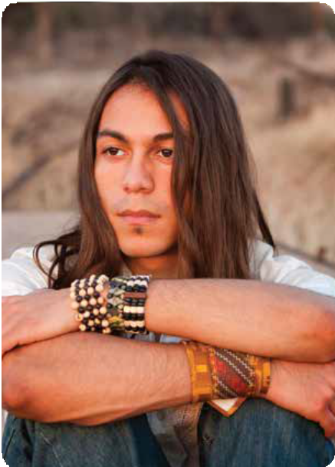

What If I Witness Bullying?
3. Redirect the situation
Research shows that peers can be very effective at intervening in a bullying situation. A creative and sometimes challenging solution is to change the direction of the situation to a more positive course. It might take some preparation, practice, planning, and extra thought—it’s not easy to speak up against a wave of negativity—but research also shows that when one person speaks up, others will follow.
Help them get away from a situation by asking them to walk with you
Change the subject when your peers start tearing someone down.
Find an adult who can come quickly and intervene.
4. Talk with an adult
In situations where you’re not sure what to do, seeking advice from an adult you trust can be helpful. An adult, such as a parent or a favorite teacher, can help you think through different ways to respond, while ensuring everyone stays safe.
Here are some ideas for talking with an adult:
Let them know that you’re coming to them for advice
If you don’t want to share everything, let the adult know that there are certain things you are not ready to share and ask them to respect that
Ask, “What can be done so that we can help and we can all feel safe?”
Decide what steps you can take together.
12
Notes:
Slide title: What If I Witness Bullying?
Objective: Give students more tips on what they can do if they see bullying
3. Redirect the situation
Research shows that peers can be very effective at intervening in a bullying situation. A creative and sometimes challenging solution is to change the direction of the situation to a more positive course. It might take some practice, planning, and extra thought—it’s not easy to speak up against a wave of negativity—but research also shows that when one person speaks up, others will follow.
If you see bullying in person, you can:
Help the person being bullied get away from the situation
Invite another friend or two to join you as there is safety and support in numbers
Change the subject when your peers start tearing someone down
Find an adult who can quickly intervene
If you see cyberbullying, you can:
Write something positive in response
Contact the person being bullied and let them know you are there for them
Report it to a parent or an adult at school
4. Talk with an adult
When you witness bullying, whether you see it in person or online, it can be upsetting and difficult to respond to. Some situations are clear cut, like physical fights, and you know that telling an adult will keep everyone safe.
Many bullying situations can be much more complicated. When the bullying happens through gossip, name calling, intimidation, or trying to damage someone’s reputation, it can involve private, confidential details that another person doesn’t want shared. Maybe your friend is doing the bullying and you don’t want them to get in trouble.
In situations where you’re not sure what to do, seeking advice from an adult you trust can be helpful. An adult, such as a parent or a favorite teacher, can help you think through different ways to respond while ensuring everyone stays safe.

