Slide 1
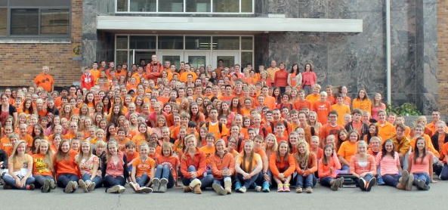
Unity and Bullying Prevention
What’s the connection?
Notes:
Slide title: Cover Slide
Objective: Slide to show onscreen pre-presentation
PACER’s National Bullying Prevention Center
Is a program of PACER Center
8161 Normandale Blvd. | Bloomington, MN 55437
952.838.9000
bullying411@PACER.org
PACER.org/Bullying
Founded in 2006, PACER's National Bullying Prevention Center actively leads social change to prevent childhood bullying, so that all youth are safe and supported in their schools, communities and online. PACER provides innovative resources for students, parents, educators, and others, and recognizes bullying as a serious community issue that impacts education, physical and emotional health, and the safety and well-being of students..
PACER.org/Bullying: This is the portal page for parents and educators to access bullying resources, which include educational toolkits, awareness toolkits, contest ideas, promotional products and more.
PACERTeensAgainstBullying: Created by and for teens, this website is a place for middle and high school students to find ways to address bullying, to take action, to be heard, and to own an important social cause.
PACERKidsAgainstBullying: A creative, innovative and educational website designed for elementary school students to learn about bullying prevention, engage in activities and be inspired to take action

Slide 2
What Does UNITY Mean?
Unity
According to Webster’s English Dictionary:
------------------------------
noun, plural u•ni•ties.
The state of being one; oneness of mind, feeling; concord, harmony, or agreement
Notes:
Slide title: What Does UNITY Mean?
Objective: Slide to introduce students to the
concept of unity and what the formal definition
is.
Read slide to students and then use optional discussion questions to further the conversation:
What is your own definition of unity?
What are synonyms for UNITY

Slide 3
Connection between
Unity and Bullying Prevention
Bullying prevention isn’t just up to one person, one school, or one community group. It’s takes all of us to create safe and supportive schools. When we join together, we can send the unified message to students who experience bullying that they aren’t alone.
_____________________________________
When we stand together, no one stands alone.
Notes:
Slide title: Connection between Unity and
Bullying Prevention
Objective: Make the connection between Unity
and Bullying Prevention, showing the relationship
Between the two concepts.
Read slide to students and then use optional discussion questions to further the conversation:
When we are united, how do you think that helps prevent bullying?

Slide 4
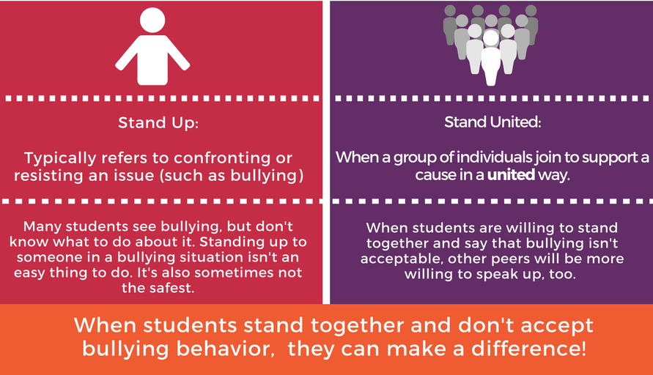
“Stand Up” vs. “Stand United”
Notes:
Slide title: Difference between Stand Up and
Stand United.
Objective: Show students that they don’t have to
stand up to bullying alone, as this is often an
intimidating thing to do. Clarifying the difference
between standing up (alone) and standing united
shows the power in numbers.
Read slide to students and then use optional discussion questions to further the conversation:
Do you think it’s easier to stand up in a bullying situation alone or with your friends / peers? Why?
Do you think students are more likely to join together for a cause when they see their friends or other peers doing it? Why or why not?

Slide 5
Standing United For
Kindness
Definition of “kindness,” according to Webster’s English Dictionary:
The quality of being friendly, generous, and considerate.
Ideas for uniting for kindness:
  Give a random compliment to a peer. It only takes one sentence!
  Write a positive message on a Post-it note and leave it on someone’s desk or locker.
  Other ideas?
Notes:
Slide title: Standing United for Kindness
Objective: Understanding what kindness means
and how to unite for kindness.
Read slide to students and then use optional discussion questions to further the conversation:
What are other ways to unite for kindness?
How do you think kindness make a difference in preventing bullying?

Slide 6
Standing United For
Acceptance
Definition of “accepting,” according to Webster’s English Dictionary:
Tending to regard different types of people and ways of life with tolerance and acceptance
Ideas for uniting for acceptance:
  Talk to someone at school that you may think you don’t have much in common with. Ask about their interests – you may be surprised!
  Hold the door open for someone and say hello.
  Other ideas?
Notes:
Slide title: Standing United for Acceptance
Objective: Understanding what acceptance means
and how to unite for acceptance.
Read slide to students and then use optional discussion questions to further the conversation:
What are other ways to unite for acceptance?
How do you think acceptance make a difference in preventing bullying?

Slide 7
Standing United For
Inclusion
Definition of “inclusion,” according to Webster’s English Dictionary:
Something taken in as part of a whole.
Ideas for uniting for inclusion:
  Invite someone new to sit with you at lunch.
  If you see someone alone at recess or during extended break, start a conversation with them. Ask how their day is going!
  Other ideas?
Notes:
Slide title: Standing United for Inclusion
Objective: Understanding what inclusion means
and how to unite for inclusion.
Read slide to students and then use optional discussion questions to further the conversation:
What are other ways to unite for inclusion?
How do you think inclusion make a difference in preventing bullying?

Slide 8
Discussion Question
How can we show UNITY in our school and community?
Notes:
Slide title: Discussion Question
Objective: Allows the students to discuss this
week’s lesson and come up with ideas on how to
show UNITY in your classroom, school, or
community. Gives students the opportunity to
reflect and apply concepts to personal life.
Discussion can be held in a large, entire class format or in smaller groups. If the discussion is in smaller groups, have one group member share what they discussed in a larger group setting.
This is also a great time to ask students if they have any questions or other thoughts after learning more about UNITY.

